Slide 1
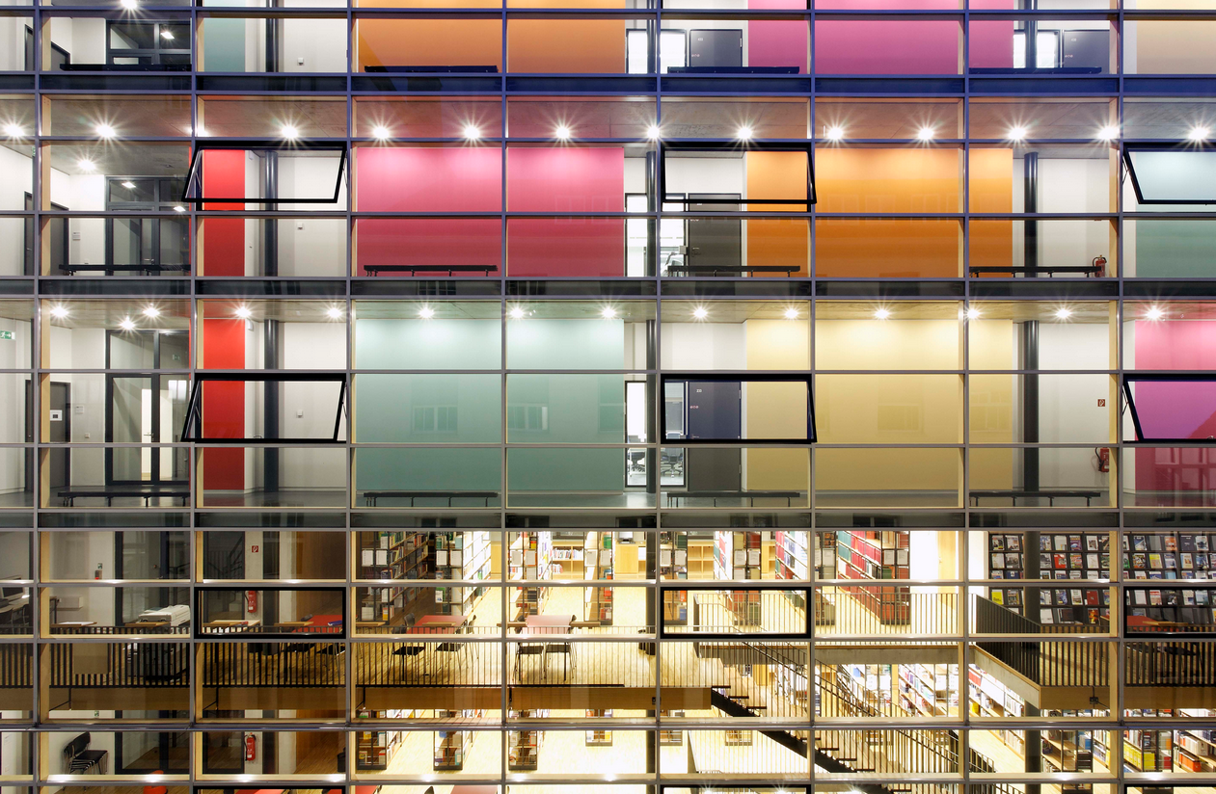

The Commons as an inner Habit
and the Impact of the OSGeo Foundation
By Hochschule für Technik Stuttgart [CC BY-SA 3.0 (http://creativecommons.org/licenses/by-sa/3.0)], via Wikimedia Commons
Franz-Josef Behr, Stuttgart University of Applied Sciences
02.10.2021, FOSS4G Asia 2021
The content is licensed under a Creative Commons-Lizenz CC BY-NC-SA.

Slide 2
My Background
Academia
12 years of (closed) GIS business (plus book author)
  IBM GFIS, MapInfo
  Municipalitiies, utility sector
Professor (since 2002)
Involved in some (own) open source projects
  SUAS MapServer (WMS, WFS)
  opencts.org/, opengeocodng.org, http://geoweb.hft-stuttgart.de/)
  Initiator of FOSS4G SEA 2012 and FOSS4G Local Chapter Malaysia
  Co-organizer of FOSS4G 2013, FOSS4G 204, FOSS4G 2016
  ICA/OSGEo lab at HFT Stuttgart

Slide 3
Outline
In some parts inspried by a presentation of Arnulf Christl, formerOSGeo President,
http://www.metaspatial.net
Short intro
The Commons and The Tragedy of Commons
Open Source
  Freedom
  Psycho-social Aspects of Motivation
Economical and technical aspects
Being represented: Structure and impact of the OSGeo Foundation
Outlook
  Academic educatio

Slide 4
Commons - Common-Pool Resources (CPRs)

Slide 5
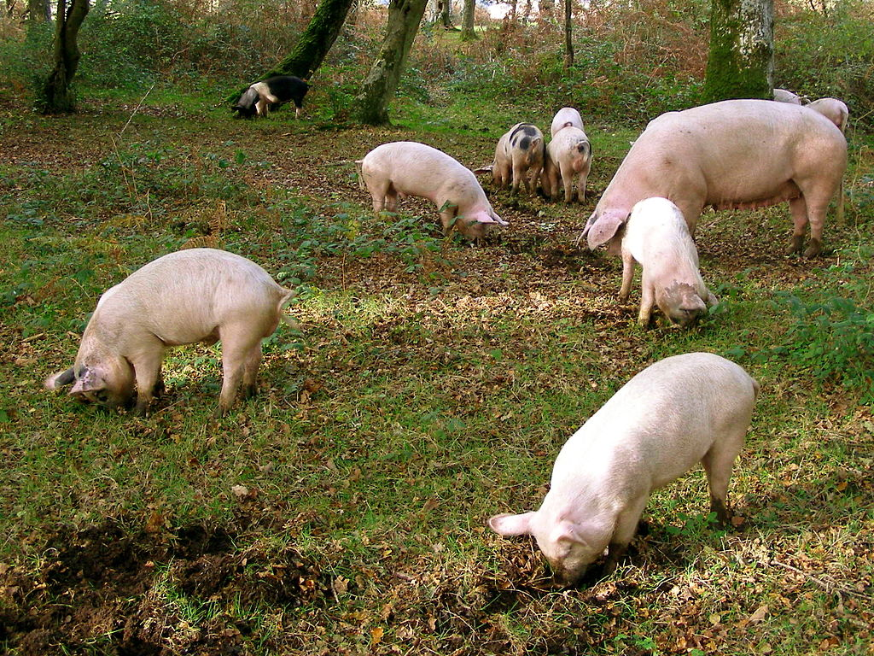
Notes:
Common land is land owned collectively by a number of persons, or by one person, but over which other people have certain traditional rights, such as to allow their livestock to graze upon it, to collect wood, or to cut turf.

Slide 6
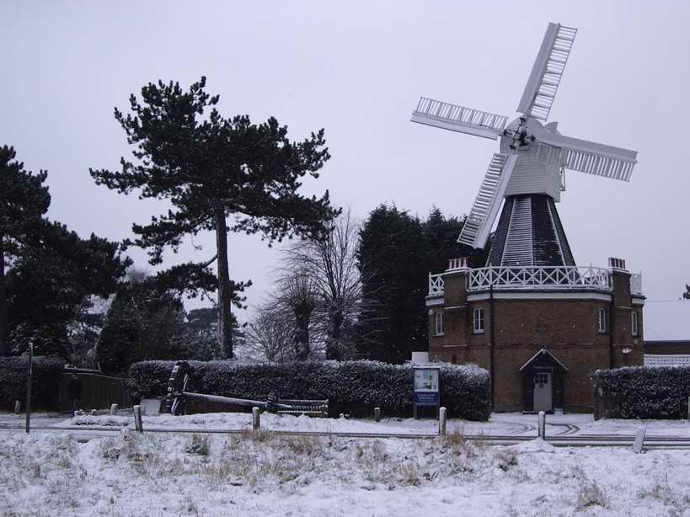
The windmill on Wimbledon Common..By Adrian Robson at English Wikipedia - Transferred from en.wikipedia to Commons by Small-town hero., Public Domain, https://commons.wikimedia.org/w/index.php?curid=4116885
Notes:
As well we have examples of shared infrastructure like the former windmill on Wimbledon Common which was built in 1817 by Charles March to serve the local community (https://www.wpcc.org.uk/families-education/windmill).

Slide 7
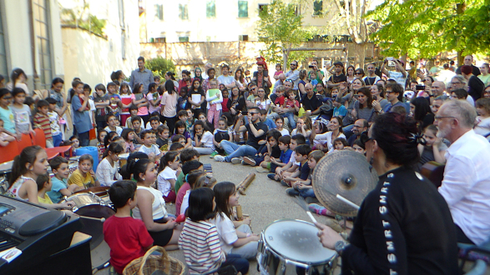
https://commons.blog/2018/06/14/commoning-florence-the-city-the-commons-the-flower/
Notes:
Wonderful parks and playgrounds, public sports centres and swimming pools, galleries, allotments and public transport networks
https://www.theguardian.com/commentisfree/2017/oct/11/labour-global-economy-planet [2019-05-08]
Urban residents share access to a number of Urban common resources in which they have a common and shared interest.
These resources range from local streets and parks to public places to a variety of shared neighborhood amenities like playgrounds, public sports centres and swimming pools.
The management and governance of these resources face the same challenges as there rural counterparts.

Slide 8
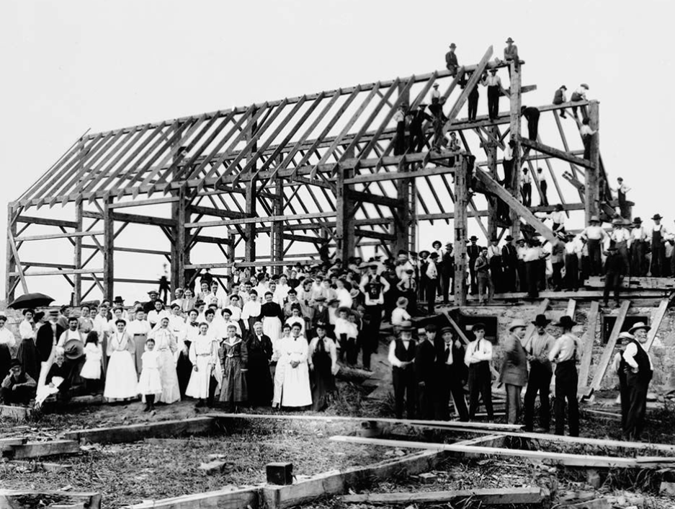
By Alexander W. Galbraith [Public domain or Public domain], via Wikimedia Commons
https://upload.wikimedia.org/wikipedia/commons/a/ab/Barn_raising_in_Lansing.jpg
Notes:
This photo shows the collaborative effort of barn raising in which a barn for one of the community members is built or rebuilt collectively by members of the community because this work can not be done by a single person or a family alone. The barn is necessary for any farmer, for example for storage of cereals and hay and keeping of animals.
The tradition of "barn raising" still exists in some Amish and Old Order Mennonite communities in the USA.
https://en.wikipedia.org/wiki/Barn_raising

Slide 9
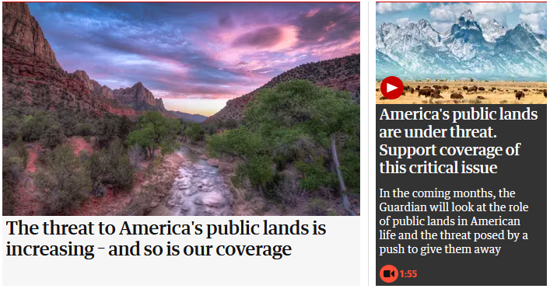
https://www.theguardian.com/environment/series/this-land-is-your-land [2019-05-12]
https://www.theguardian.com/environment/public-lands

Slide 10
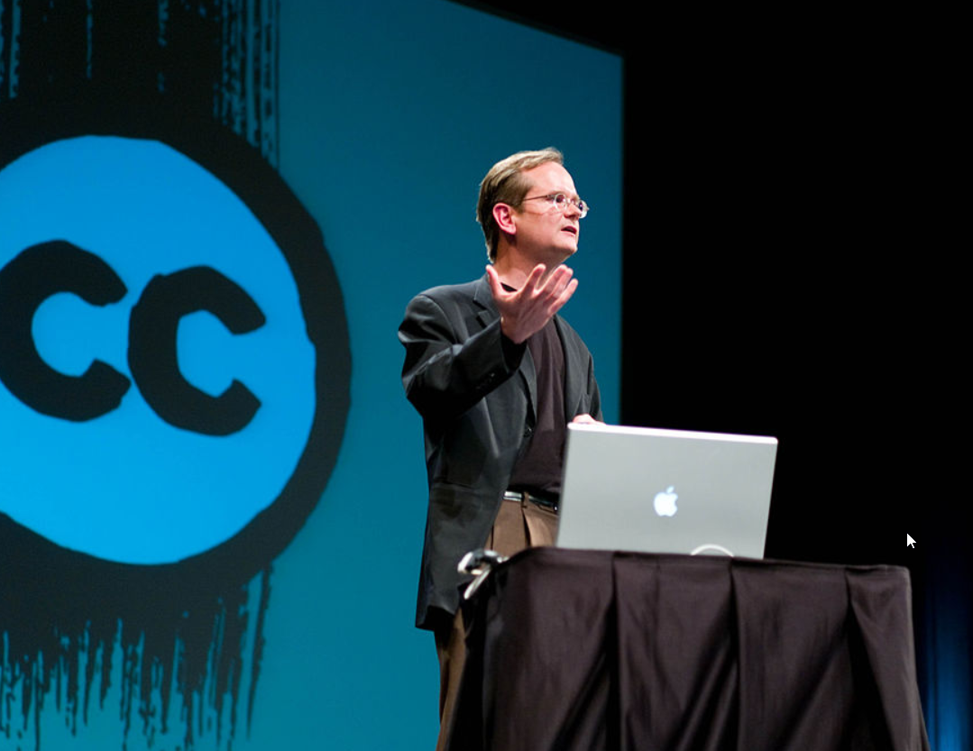
Creative Commons Licenses
By Joi [CC BY 2.0 (https://creativecommons.org/licenses/by/2.0)], via Wikimedia Commons, https://commons.wikimedia.org/wiki/File:Lawrence_Lessig_(9).jpg [2018-10-15]
Notes:
I assume we all know and apply one of the Creative Commons licenses. This movement was initially co-founded by the Professor of Law at Harvard, Lawrence Lessig, whom you can see on the slide.
The Creative Commons approach was and is intended to support the impact of "commons" in the "information age".
https://en.wikipedia.org/wiki/Creative_Commons
These licenses allow us, the creators of scientific work, to communicate which rights they reserve, and which rights they waive for the benefit of recipients or other creators.
According to Wikipedia there were about 1.4 billion works licensed under the various Creative Commons licenses. Wikipedia as well uses one of these licenses.

Slide 11
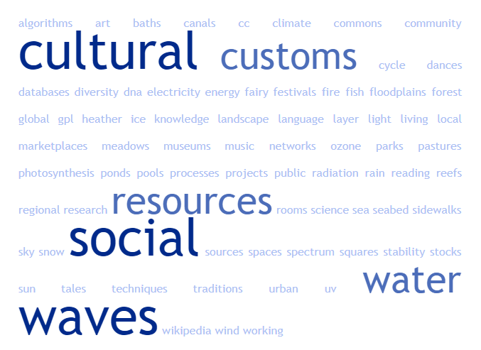
Commons – Allmende - everywhere
local, regional or global natural, social and cultural resources and processes, floodplains, ponds, cultural techniques (reading, writing, algorithms), photosynthesis, sky, forest, meadows, pastures, reefs, spectrum, DNA, water (and water cycle), sun, wind, rain, ice, snow, electricity, fire, silence, heather, canals, biodiversity, sense, waves (light waves, waves of the sea, ...), landscape, seabed, fish stocks, energy sources, UV radiation, stability of the climate, cultural diversity (music, Dances, language, customs), ozone layer, urban commons and public spaces (squares, parks, sidewalks), Wikipedia, GPL / CC, museums, knowledge resources (libraries, research results / pools, databases), science, customs and traditions, festivals, marketplaces ,
Community projects on living & working, art, baths, time, fairy tales, social networks, social rooms and much more
After https://commons.blog/was-sind-commons/ [2018-10-11]
Notes:
Basically we can see that we have commons everywhere.
Commons allow us as human beings to live.
Now to the Tragedy of Commons.
https://commons.blog/was-sind-commons/:
Der Begriff der Gemeinschaftsgüter bezieht sich auf zwei zentrale Kategorien. Erstens auf endliche, materielle, natürliche Ressourcen wie Rohstoffe, Energieträger, Wasser, Wald u.v.m. und zweitens auf nicht fassbare, immaterielle, intellektuelle Ressourcen wie Wissen und Ideen – die codes der Informationsgesellschaft (Software) und die codes des Lebens; die Wissensallmende.
… local, regional oder global. Natürliche, soziale und kulturelle Ressourcen und Prozesse wie….Auen, Teiche, Kulturtechniken (Lesen, Schreiben, Algorithmen), Fotosynthese, Organe, Moore, Firmament, Wald, Wiesen, Weiden, Spektrum, DNA, Wasser (und Wasserkreislauf), Regen, Eis, Schnee, Elektrizität, Feuer, Stille, Heide, Kanäle, Artenvielfalt, Sinnsprüche, Wellen (Lichtwellen, Wellen des Meeres…), Land (-schaft), Meeresboden, Fischbestände, Energieträger, UV Strahlung, Stabilität des Klimas, kulturelle Vielfalt (Musik, Tänze, Sprache, Bräuche), Ozonschicht, städtische commons (Plätze, Parks, Gehsteige), Triften, Wikipedia, GPL/CC, Museen, Wissensbestände (Bibliotheken, Forschungsergebnisse/-pools, Datenbanken), Wissenschaft, Bräuche und Traditionen, Festivals, Marktplätze, Gemeinschaftsprojekte zum Leben & Arbeiten, Kunst, Bäder, Zeit?, Riffe, Märchen, soziale Netze und Räume u.v.m.

Slide 12
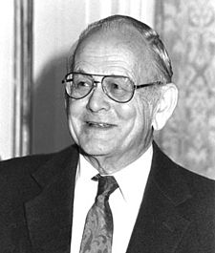
The Tragedy of Commons
"Therein is the tragedy. Each man is locked into a system that compels him to increase his herd without limit - in a world that is limited".
(Garrett Hardin 1968, p. 1.244, cited after Ostrom 1999)
https://en.wikipedia.org/wiki/Garrett_Hardin
Notes:
According to Garrett Hardin (1968)
everybody is locked into a system that compels him to increase his [own] herd without limit - in a world that is limited.
he argues that any economy based on long-term compound interest must eventually fail due to the physical and mathematical impossibility of long-term exponential growth on a finite plane

Slide 13
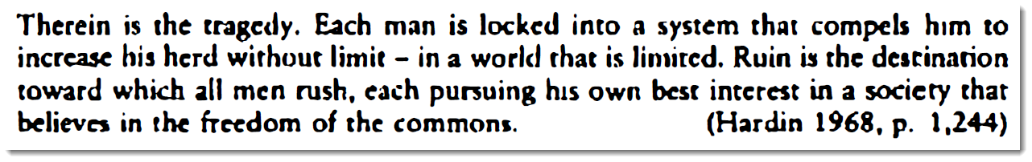
The Tragedy of Commons
"Ruin is the destination toward which all men rush, each pursuing his own best interest in a society that believes in the freedom of the common".
(Hardin 1968, p. 1.244, https://www.science.org/lookup/doi/10.1126/science.162.3859.1243, cited after Ostrom 1999)
Notes:
Garrett Hardin continues:
“Ruin is the destination toward which all men rush, each pursuing his own best interest in a society that believes in the freedom of the resources.”
In the context of natural resources like Common Land we can think about Overgrazing by someone’s livelihood.
To pursue his own interests somebody takes an inadequate part of the commons.

Slide 14
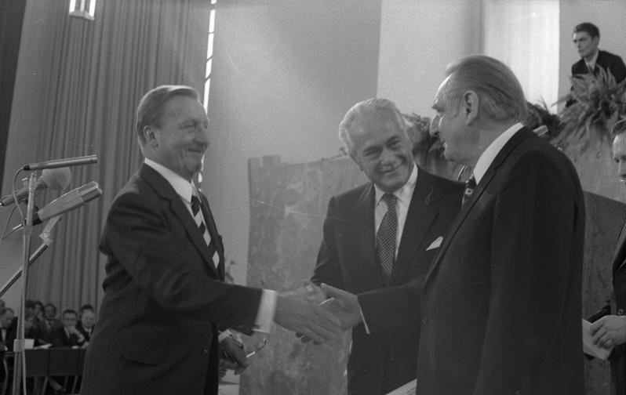

The Limits to Growth (1972)
www.donellameadows.org/wp-content/userfiles/Limits-to-Growth-digital-scan-version.pdf
Von Bundesarchiv, B 145 Bild-F041173-0013 / Reineke, Engelbert / CC-BY-SA 3.0, CC BY-SA 3.0 de, https://commons.wikimedia.org/w/index.php?curid=5456321
By Source, Fair use, https://en.wikipedia.org/w/index.php?curid=14973229
Notes:
These limits are also the prominent topic of the book Limits to Growth published 1972 by the Club of Rome.
It reports on the computer simulation of exponential economic and population growth with a finite supply of resources.
Funded by the Volkswagen Foundation[3] and commissioned by the Club of Rome, the findings of the study were first presented at international gatherings in Moscow and Rio de Janeiro in the summer of 1971.
The photo shows the award ceremony of the prestigious Peace Prize of the German Book Trade organization to representatives of the Club of Rome

Slide 15
The Tragedy of Commons
"Overgrazing."
"Taking too much from limited resources."

Slide 16
Two examples of dichotomies
Notes:
Two examples of dichotomy regarding overgrazing and limited resources

Slide 17
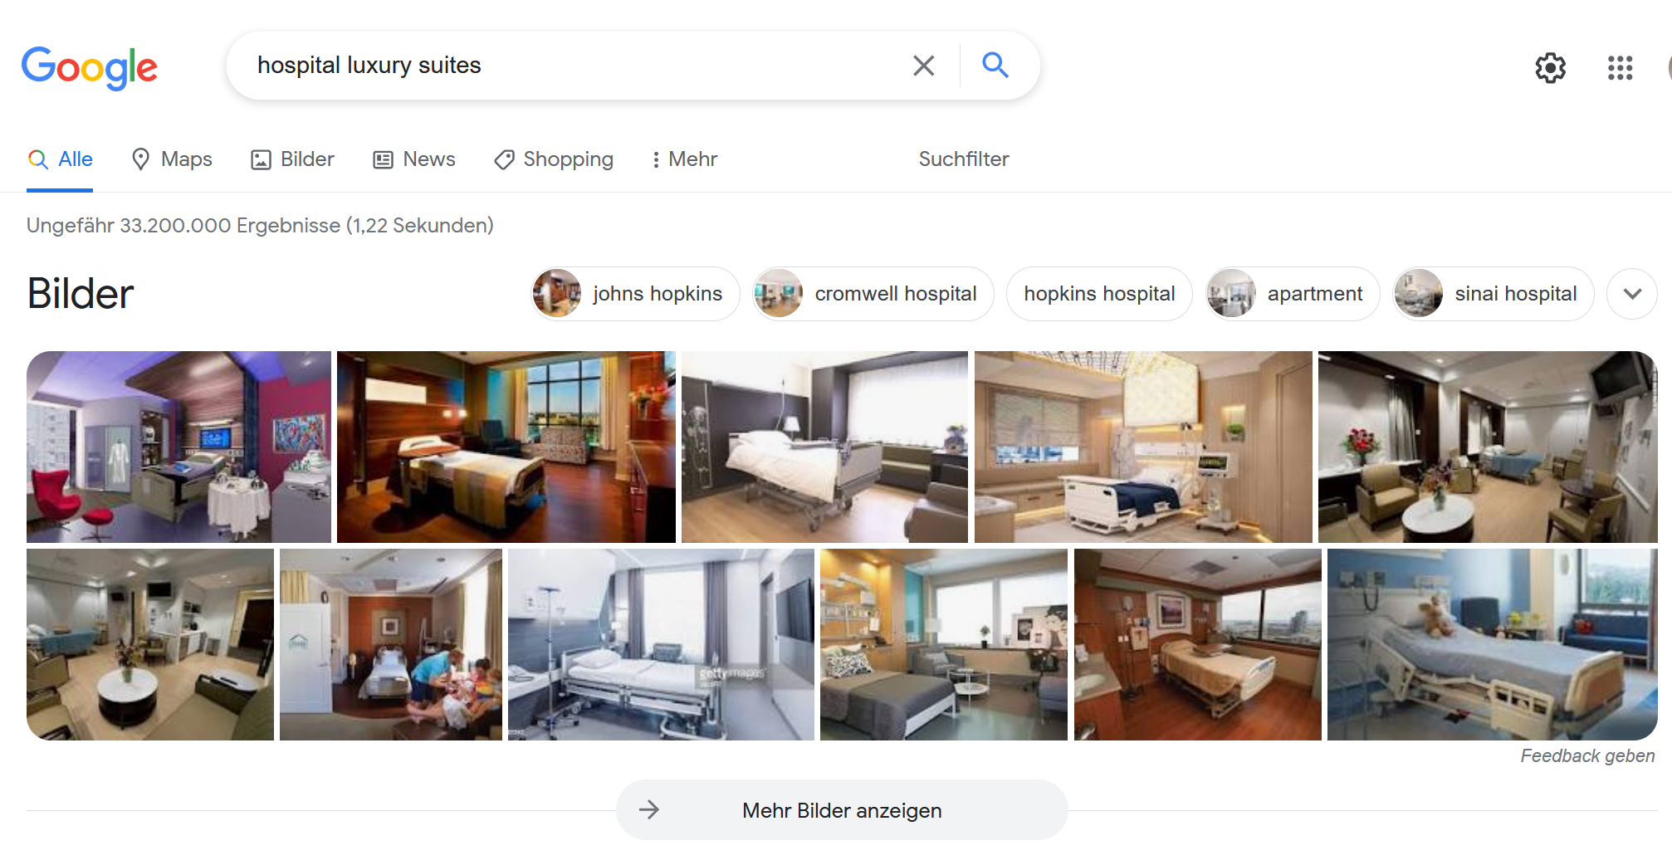
https://www.google.com/search?q=hospital+luxury+suites&source=lmns&bih=996&biw=1235&sa=X&ved=2ahUKEwjci_SwwanzAhVGr6QKHTAXBf0Q_AUoAHoECAEQAA [2021-10-01]
Notes:
The first dichotomy deals with health provision, here care-taking in hospitals.
Here you see some results when I searched for hospital luxury suites in the word wide web. You can see how people can cure their illness (in some parts of the earth).

Slide 18
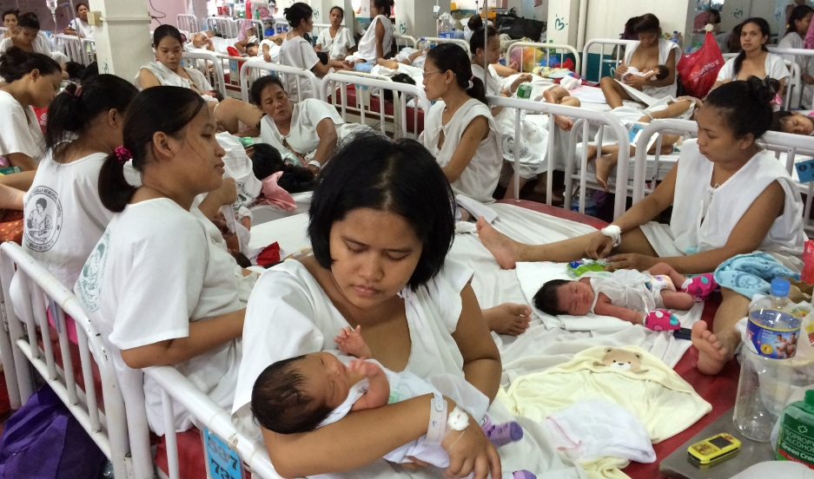
Fabella Hospital in Manila. Credit: Sonia Narang: https://www.pri.org/stories/2015-03-05/manila-baby-factory-why-women-put-crowding-four-or-more-bed-after-giving-birth [2018-10-11]
Notes:
In contrary this slide shows the crowded maternity ward at Fabella Hospital in Manila overflows with hundreds of new moms. There aren’t enough beds for everyone, so they share, four or five to one bed.
The babies, some of them wrapped in blankets, lie in the middle. Young mothers sit in blood-streaked, thin, white hospital gowns that curl up on their sides. Most of the women who give birth at Fabella come from poor communities around Manila. Here, they only have to pay what they can afford.
"The crowded maternity ward at Fabella Hospital in Manila overflows with hundreds of new moms. There aren’t enough beds for everyone, so they share, four or five to a bed.
The babies, some of them wrapped in blankets, lie in the middle. Young mothers sit in blood-streaked, thin, white hospital gowns that curl up on their sides. Most of the women who give birth at Fabella come from poor communities around Manila. Here, they only have to pay what they can afford."
Former Congresswoman Risa Hontiveros: “If you had just a minimum wage in a day would you spend it for a pack of pills or a pack of condoms, or would you spend it for a kilo of rice?”

Slide 19
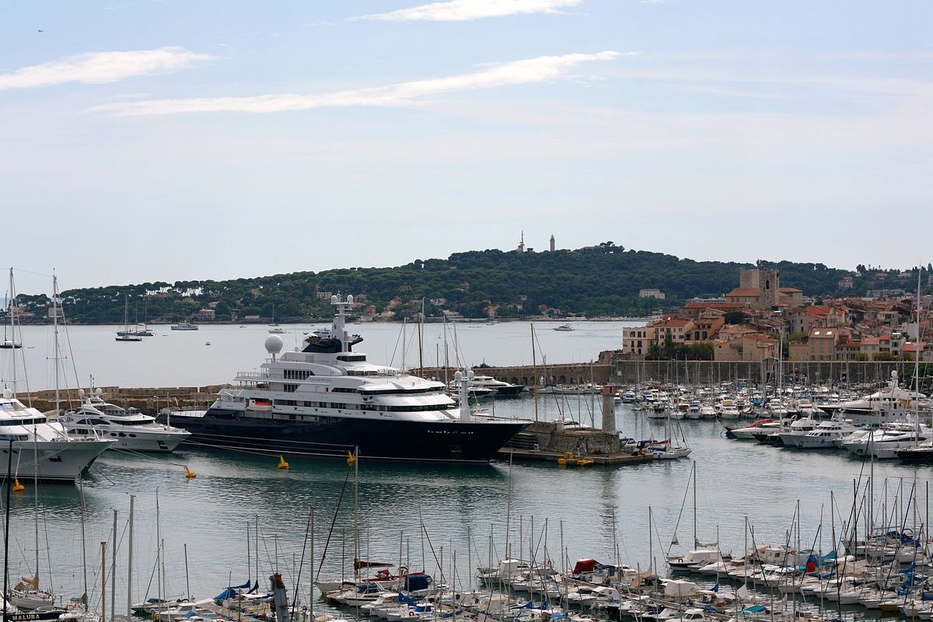
Octopus built-in 2003 … is owned by Paul Allen, co-founder of Microsoft. who also owns another of the world's 100 largest yachts, and RV Petrel, a highly advanced deep water research vessel "… costs $384,000 a week to run" [1]
By Plyd (talk) - Own work, Public Domain, https://commons.wikimedia.org/w/index.php?curid=7856650 [2018-0
[1] https://www.theguardian.com/lifeandstyle/shortcuts/2018/aug/01/why-the-super-rich-are-taking-their-mega-boats-into-uncharted-waters?utm_source=esp&utm_medium=Email&utm_campaign=GU+Today+main+NEW+H+categories&utm_term=282592&subid=21316034&CMP=EMCNEWEML6619I2 8-04]
Notes:
Example 2 has to do with naval transportation. The photo the shows “Octopus”, one of greatest yachts, one of the yachts owned by Paul Allen, the co-founder of Microsoft. It is reported that this vessel costs 384 thousand US$ per week to run.

Slide 20
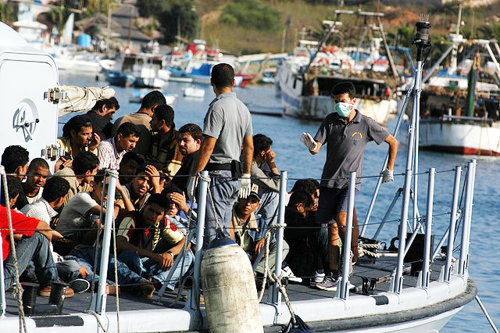
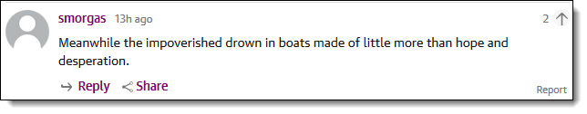
By Sara Prestianni / noborder network - https://www.flickr.com/photos/noborder/2495544558/, CC BY 2.0, https://commons.wikimedia.org/w/index.php?curid=13291993
Notes:
The next photo is taken in the Mediterranean Sea near the island of Lampedusa, showing the conditions of travel for people seeking their fortune in the European Union.
These examples led me to a very old peace of art.

Slide 21
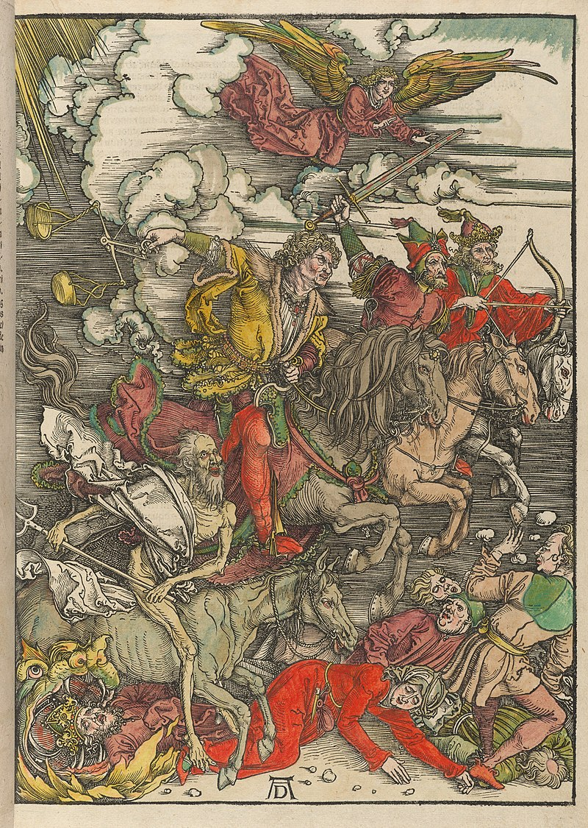
Von Albrecht Dürer - Typ Inc 2121A, Houghton Library, Harvard University, Gemeinfrei, https://commons.wikimedia.org/w/index.php?curid=34832257
Notes:
… created by a Albrecht Dürer, a German painter and printmaker who lived mainly in Nuremberg, Germany 21 May 1471 – 6 April 1528.
Dürer depicts in the year 1500 the christan Book of Revelation across 15 woodcuts. One of them, the four horsemen, can be seen here.
The horseman furthest right is Conquest. The painter denotes Conquest with his bow and arrow, the triumph of the power.
The second horseman from the right is war, the fascination of force and violence. His weapon, a longsword, is held high and ready for battle.
Let me attract your attention to the third horseman, characterized by a scales as his weapon. He can be interpreted as famine, or the desire of greed. The scales represent how food can be rationed and highly priced as well as the missing balance and justice. The greed is the main impetus, the main player who leads the other horseman, accompanied by the fourth and final horseman, representing Death.
The fourth seal is the most distinctive horseman as he is noticeably older than the other horseman and incredibly malnourished. Much like his rider, Death's horse is also in an emaciated state, appearing to painfully and directly trample those in his path.
https://commons.wikimedia.org/wiki/Category:Four_Horsemen_of_the_Apocalypse_by_Albrecht_D%C3%BCrer?uselang=de#/media/File:Houghton_Typ_Inc_2121A_-_D%C3%BCrer,_Apocalypse,_23.jpg
Only a few years later, in 1524, Martin Luther, already wrote:

Slide 22
Martin Luther (1524):
„… the merchants among themselves have a common rule, that is their main motto and the reason for all finances, that they say: I may give my goods as expensive as I can. They think that's a right.
This has given way to avarice, and all the gates and windows of hell have been opened.
Is it different to: I ask nothing about my neighbor, if only I had full of my profit and greed; what is it to me that it harms my neighbor?”
Martin Luther (1524): Von Kaufshandlung und Wucher 1524, WA 15

Slide 23
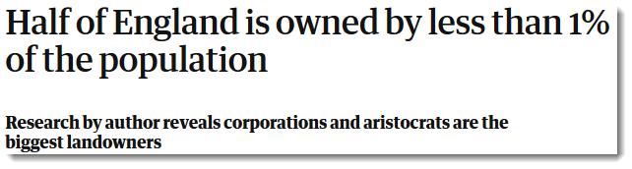
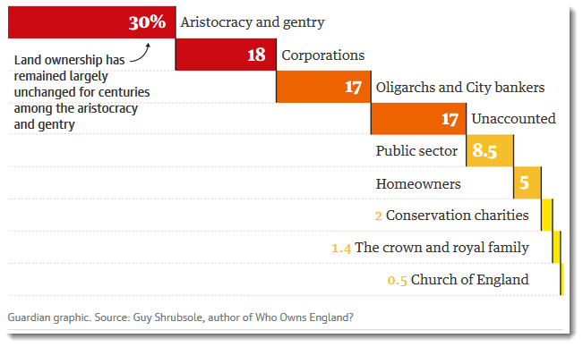
https://www.theguardian.com/money/2019/apr/17/who-owns-england-thousand-secret-landowners-author?utm_term=RWRpdG9yaWFsX0d1YXJkaWFuVG9kYXlVS19XZWVrZGF5cy0xOTA0MTg%3D&utm_source=esp&utm_medium=Email&utm_campaign=GuardianTodayUK&CMP=GTUK_email [2019-04-18]

Slide 24
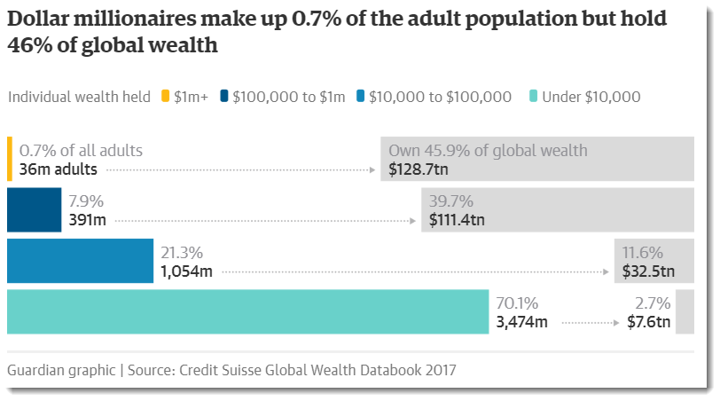
https://www.theguardian.com/inequality/2017/nov/14/worlds-richest-wealth-credit-suisse [2018-10-11]
Notes:
This evident disparity of income is widely known and can be seen in the info graphic published by The Guardian.
Wealth is defined as the current market value of all the assets owned by households, net of all their debts.
Wealth is defined as the current market value of all the assets owned by households, net of all their debts.
A key regularity across the world is:
The lower 50 percent of the wealth distribution owns almost no wealth in total as its debts are as big as its assets!
Source: GABRIEL ZUCMAN (): Wealth Inequality. The Stanford Center on Poverty and Inequality. https://inequality.stanford.edu/sites/default/files/Pathways-SOTU-2016-Wealth-Inequality-3.pdf

Slide 25
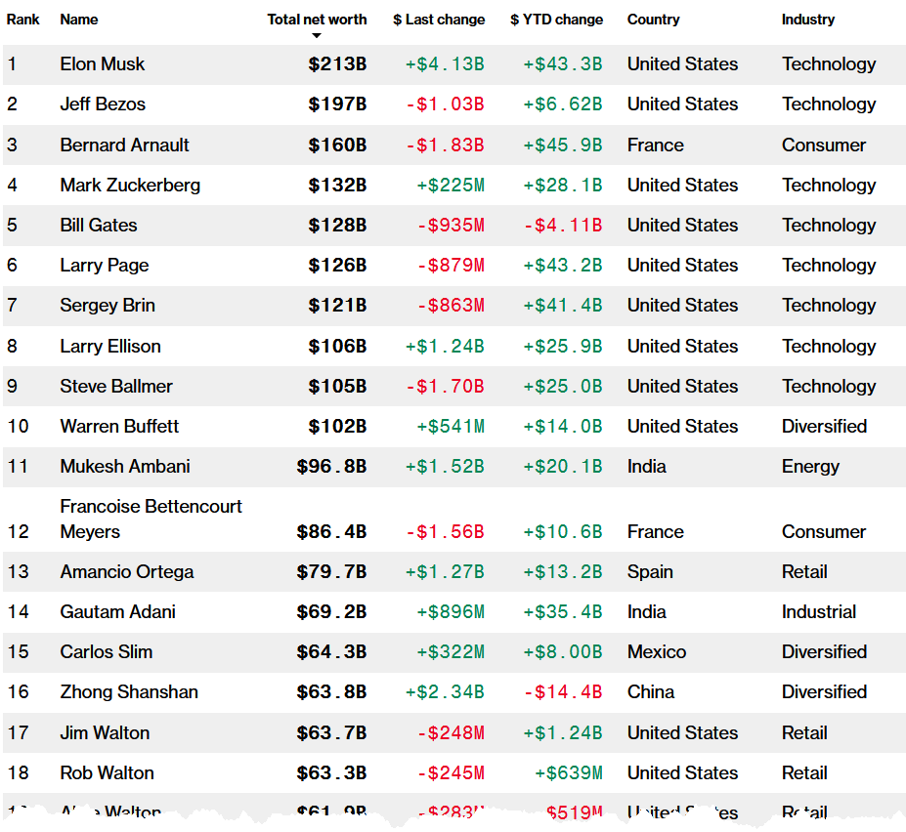
https://www.bloomberg.com/billionaires/ [2018-09-29]
Notes:
Perhaps also widely known are the lists of billionaires published by Bloomberg and Forbes. Well, I guess, most of you will know names like Jeff Bezos, Bill Gates, Warren Buffet and so on.
If we have a closer look we can recognize a predominance of richness in one country.
As well we recognize that a lot of riches are adjunct to technology, especially Information technology.
Some of these people respectively companies earn their income partially related to geospatial data processing (like DBMS, Web mapping, Routing).
Bezos is the founder and largest shareholder of Amazon, the world's biggest online retailer.
Ballmer is the former CEO of Microsoft, the world’s biggest software maker.
Especially close to Geospatial IT is number 496 of the billionaires…

Slide 26
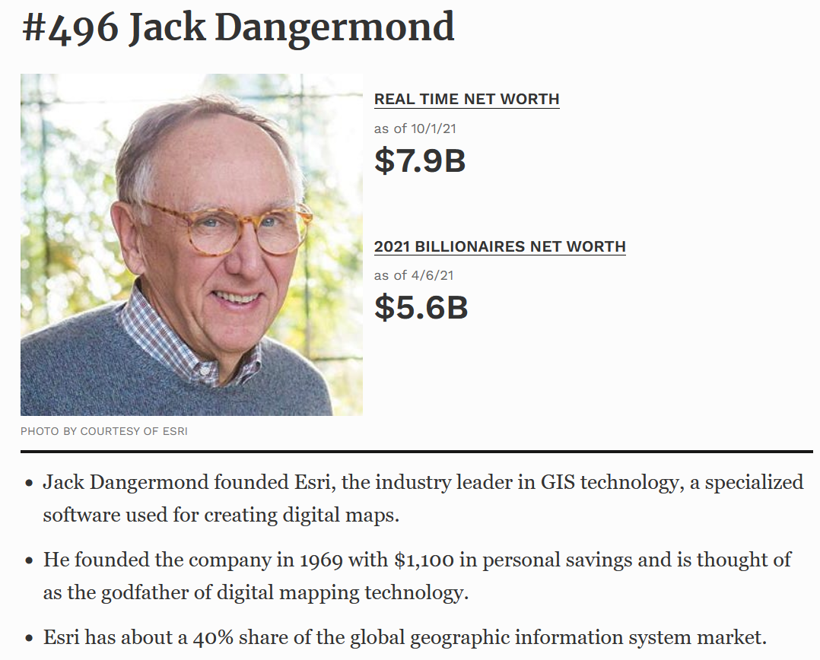
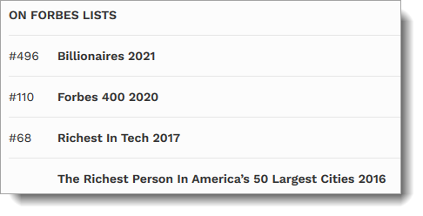
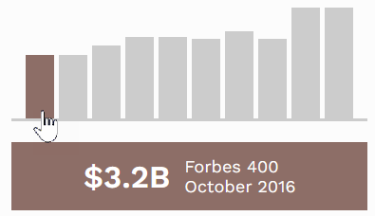
https://www.forbes.com/profile/jack-laura-dangermond/?list=billionaires [2021-04-07]
Notes:
… because Jack Dangermond, the founder of Ersi, "The Godfather of Digital Maps" (https://www.forbes.com/sites/miguelhelft/2016/02/10/the-godfather-of-digital-maps/#4c9aa4c74da9) appears also on the list.
I happened to meet him Jack once, around 1995 I guess. A sympathetic man. An important contributer to our geospatial field and business who is supposed to own more than 5 Billion US$.
Esri, as it is reported, owns more than half of the GIS market, and its technology is used around the world by some 350,000 businesses, government agencies and NGOs, which collectively create 150 million new maps every day.

Slide 27
Commons
cultural and natural resources accessible to all members of a society, including natural materials such as air, water, and a habitable earth. These resources are held in common, not owned privately.
Natural resources that groups of people (communities, user groups) manage for individual and collective benefit.
Characteristically, this involves a variety of informal norms and values (social practice) employed for a governance mechanism
Commons can be also defined as a social practice of governing a resource not by state or market but by a community of users that self-governs the resource through institutions that it creates .
Source: Wikipedia

Slide 28
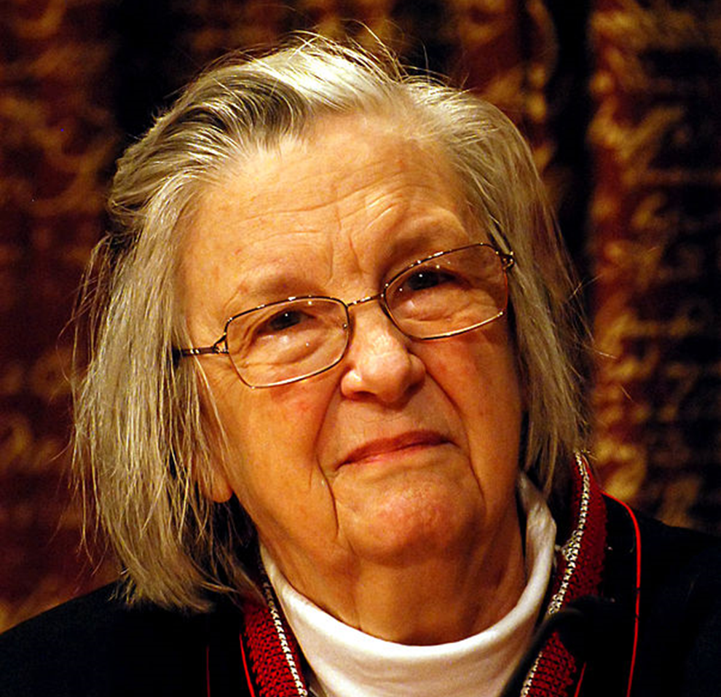
Elinor Ostrom, Nobel Laureat about "analysis of economic governance, especially the commons"
By © Holger Motzkau 2010, Wikipedia/Wikimedia Commons (cc-by-sa-3.0), CC BY-SA 3.0, https://commons.wikimedia.org/w/index.php?curid=10997825
Notes:
Now back from this excursion to the Commons and the findings of Elinor Ostrom, Nobel Laureat about "analysis of economic governance, especially the commons".
Elinor Claire "Lin" Ostrom (1933 –2012) was an American political economist, a lead researcher for the Sustainable Agriculture and Natural Resource Management.
The consumption and governance of natural resources used by many individuals in common is an issue of increasing concern to policy analysts. Both state control and privatization of resources have been advocated, but neither the state nor the market have been uniformly successful in solving common pool resource problems.
https://www.ukessays.com/essays/information-technology/open-source-thomas-friedman-fourth-flattener-information-technology-essay.php

Slide 29

What one can observe in the world, however, is that neither the state nor the market is uniformly successful in enabling individuals to sustain long-term, productive use of natural resource systems.
Notes:
In her book “Governing the Commons” Elinor Ostrom provides a unique body of empirical data to explore conditions under which natural common pool resource problems have been satisfactorily or unsatisfactorily solved.
The cases considered are natural resource like communal tenure in meadows and forests, irrigation communities and other water rights, and fisheries.
One central message of her research is: “that neither the state nor the market is uniformly successful in enabling individuals to sustain long-term, productive use of natural resource systems.”
https://www.ukessays.com/essays/information-technology/open-source-thomas-friedman-fourth-flattener-information-technology-essay.php
How to overcome this limitation?
She points out that common pool problems sometimes are solved by voluntary organizations rather than by the market or by a coercive state.

Slide 30
Design principles of stable local Common Pool Resource management
Clear definition of the contents of the common pool resource and effective exclusion of external un-entitled parties);
The appropriation and provision of common resources that are adapted to local conditions;
Collective-choice arrangements that allow most resource appropriators to participate in the decision-making process;
Effective monitoring by monitors who are part of or accountable to the appropriators;
Ostrom, Elinor (1990). Governing the Commons: The Evolution of Institutions for Collective Action. Cambridge University Press.
Notes:
She developed eight Design principles of stable local Common Pool Resource management.
I will show some of these principles in my further deliberations.

Slide 31
Design principles of stable local Common Pool Resource management
A scale of graduated sanctions for resource appropriators who violate community rules;
Mechanisms of conflict resolution that are cheap and of easy access;
Self-determination of the community recognized by higher-level authorities; and
In the case of larger common-pool resources, organization in the form of multiple layers of nested enterprises, with small local CPRs at the base level.
Ostrom, Elinor (1990). Governing the Commons: The Evolution of Institutions for Collective Action. Cambridge University Press.

Slide 32
Commons - Common-Pool Resources (CPRs)

Slide 33
Source
Data
Open
Standards
Education
Notes:
Now I’d like to continue with Open Source, Data, Standards and Education,
of course with focus on Open Source.
What are the motivators of to engage themselves in the Open Source community?

Slide 34
Psycho-social Aspects
Notes:
A primary motivator for many people is freedom.

Slide 35
Freedom

Slide 36
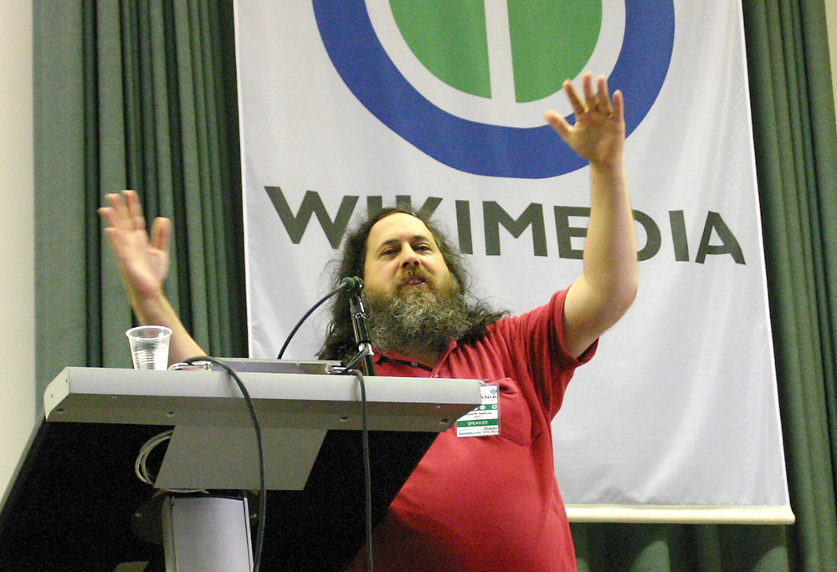
Richard Matthew Stallman
US-american activist and software developer; GNU = Gnu is not Unix (gcc, emacs, ..)
Proclaiming exchange, independence, community, collaboration, solidary
Academic background (MIT)
Founder and President of the Free Software Foundation
„Wikimania stallman keynote2“ von Elke Wetzig - Eigenes Werk. Lizenziert unter CC BY-SA 3.0 über Wikimedia Commons - http://commons.wikimedia.org/wiki/File:Wikimania_stallman_keynote2.jpg#mediaviewer/File:Wikimania_stallman_keynote2.jpg
Notes:
, Unabhängigkeit, Gemeinschaft, Zusammenarbeit, SolidarThis impetus has a long tradition and can be contributed to one of the Godfathers in this realm: Richard Matthew Stallman.
As an US-American activist and software developer he is proclaiming exchange, independence, community, collaboration, and solidary.
He is a main developer of the GNU opertating system and Founder and President of the Free Software Foundation.
Interestingly he has an academic background (MIT) – as many of us have - , and parts of his mind set can be found in many academicians.

Slide 37
Richard Matthew Stallman
Open source is a development methodology; free software is a social movement.
Why Open Source misses the point of Free Software [https://www.gnu.org/philosophy/open-source-misses-the-point.en.html [2018-10-07]]
CopyLeft: all amendments have to be published under (almost) identical license rules [http://www.gnu.org/copyleft/copyleft.de.html]
„Wikimania stallman keynote2“ von Elke Wetzig - Eigenes Werk. Lizenziert unter CC BY-SA 3.0 über Wikimedia Commons - http://commons.wikimedia.org/wiki/File:Wikimania_stallman_keynote2.jpg#mediaviewer/File:Wikimania_stallman_keynote2.jpg
Notes:
He distinguishes between Open Source as a methodology and Free Software as a philosophy and social movement.
In this context you should note the idea of the viral CopyLeft approach: all amendments to source code have to be published under (almost) identical license rules [http://www.gnu.org/copyleft/copyleft.de.html]

Slide 38
“Free Software Foundation” and its for degrees of Freedom
The freedom to run the program as you wish, for any purpose (freedom 0).
The freedom to study how the program works, and change it so it does your computing as you wish (freedom 1).
Access to the source code is a precondition for this.
The freedom to redistribute copies so you can help your neighbor (freedom 2).
The freedom to distribute copies of your modified versions to others (freedom 3).
http://www.gnu.org/philosophy/free-sw.html
https://fsf.org/
Notes:
The four degrees of Freedom of the Free Software Foundation are intensively related to the intrinsic motivation of many OS developers
The freedom to run the program
The freedom to study and mdify the program
The redistribution of the program
The redistribution of the modified program

Slide 39
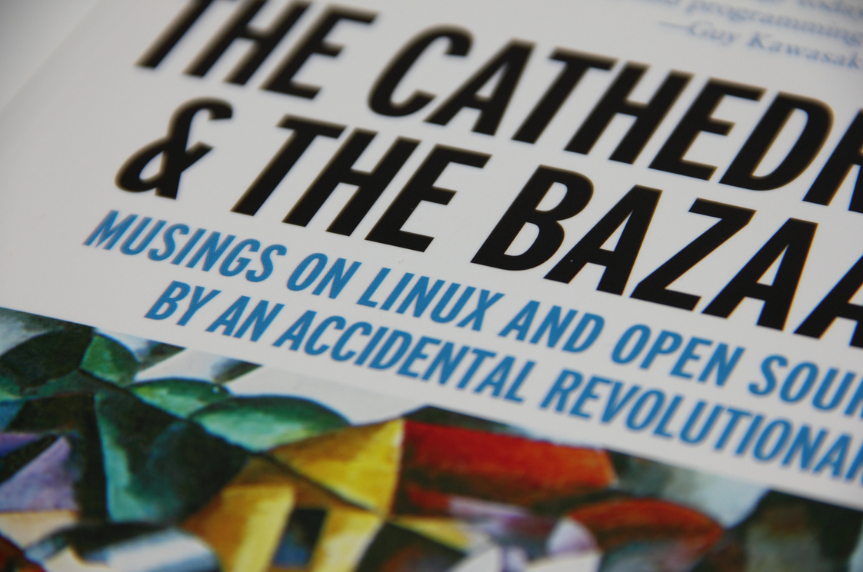
Eric S. Raymond: The Cathedral and the Bazaar (1987)
1) Every good software is written by a developer seeking to solve a personal problem.
4) If you have the right attitude, interesting problems will find you.
5) When you lose interest in a program, your last duty to it is to hand it off to a competent successor.
6) Treating your users as co-developers is your least-hassle route to rapid code improvement and effective debugging.
7) Release early. Release often. And listen to your customers.
8) Given a large enough beta-tester and co-developer base, almost every problem will be discovered quickly and be fixed by someone.
19) Given a communications medium like the Internet and the development coordinator's intelligence to lead without coercion: many heads are inevitably better than one.
https://www.flickr.com/photos/hades2k/7001927337/ CC BY-SA 2.0
Notes:
Further input came from Eric S. Raymond and his book “The Cathedral and the Bazaar”.
The author contrasts the structured form of the traditional computer software development (the Cathedral) and the altruistic generous world of open source software development (the Bazaar).
In the Bazaar, men and women invest their time to compose and/or debug software works in progress; they create it, they perfect it ... and then they make it freely available to you and me.
The author argues that the "Bazaar" methodology produces higher quality software faster than the "Cathedral" method, and how the "Bazaar" method provides longevity to software. Finally, it is shown how the spirit of software craftsmanship is nurtured by the "Bazaar" method.
https://www.amazon.com/Cathedral-Bazaar-Musings-Accidental-Revolutionary/dp/0596001088/ref=pd_sim_14_2/130-0892924-6199657?_encoding=UTF8&pd_rd_i=0596001088&pd_rd_r=f6730077-cc97-11e8-b413-df24a88cfed6&pd_rd_w=FHD1c&pd_rd_wg=v9565&pf_rd_i=desktop-dp-sims&pf_rd_m=ATVPDKIKX0DER&pf_rd_p=18bb0b78-4200-49b9-ac91-f141d61a1780&pf_rd_r=KRNAJP8SGGF9H5A4RQCH&pf_rd_s=desktop-dp-sims&pf_rd_t=40701&psc=1&refRID=KRNAJP8SGGF9H5A4RQCH
I assume that many OS developers have such motivation and habits.
We can learn here some habits of Open Source developers.
developer seek primarily to solve a personal problem
interesting problems will find the developer
The developer has to take care to fnd successors
User contribute actively as beta-testers, and hence it is recommended to release early and often, an approach we find as well in the agile software development. Errors can be detected early and corrected.
The development coordinator has to lead in an intelligent way without coercion
Jede gute Software wird von einem Entwickler geschrieben, der ein persönliches Problem lösen will.
Wenn du die richtige Einstellung hast, werden dich interessante Probleme finden.
Wenn du das Interesse an einem Programm verlierst, ist es deine Pflicht, dieses einem kompetenten Nachfolger zu übergeben.
Wenn du deine Benutzer als Mitprogrammierer betrachtest, ist dies der einfachste Weg zu schneller Verbesserung und effizientem Debugging.
Veröffentliche früh. Veröffentliche häufig. Und höre auf die Benutzer.
Mit einer hinreichend großen Gruppe von Betatestern und Mitentwicklern wird fast jedes Problem schnell erkannt und die Lösung von jemandem gefunden.
Mit genügend guter Kommunikation, wie über das Internet, und Führung ohne Zwang sind viele Köpfe immer besser als einer.

Slide 40
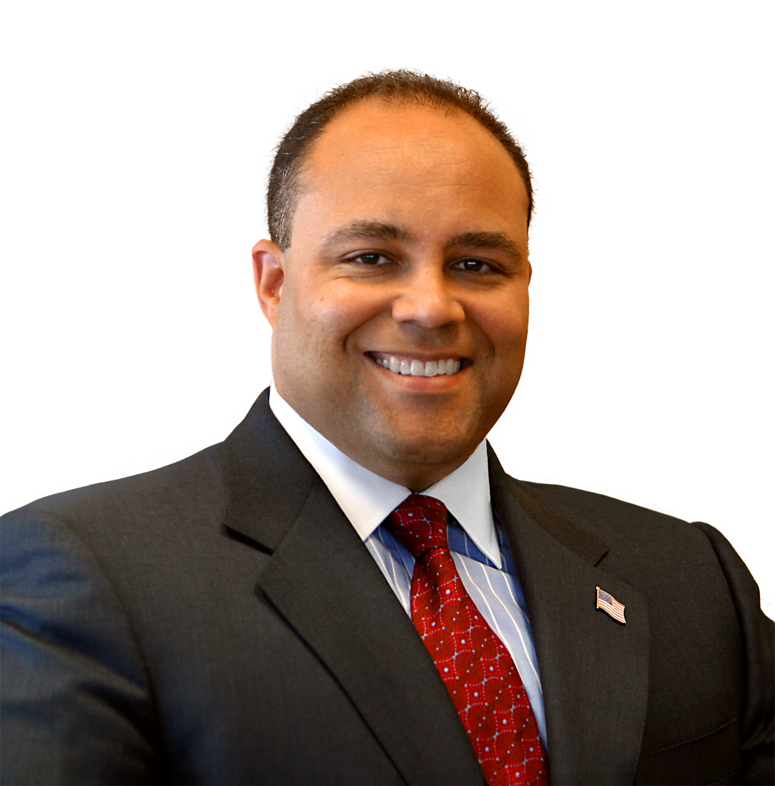
Michael Powell
former chairman of the Federal Communications Commission
"Net Freedoms":
Freedom to Access Content
Freedom to Use Applications
Freedom to Attach Personal Devices.
Freedom to Obtain Service Plan Information
By Unknown - Source: http://www.fcc.gov/commissioners/previous/powell/biography.htmlDirect URL to photo: http://www.fcc.gov/commissioners/photos/ppmkp.jpg, Public Domain, https://commons.wikimedia.org/w/index.php?curid=29458976
Michael K. Powell (2008): PRESERVING INTERNET FREEDOM: GUIDING PRINCIPLES FOR THE INDUSTRY. https://docs.fcc.gov/public/attachments/DOC-243556A1.pdf [2018-10-15]

Slide 41
Psycho-social Aspects:
Membership in a community

Slide 42
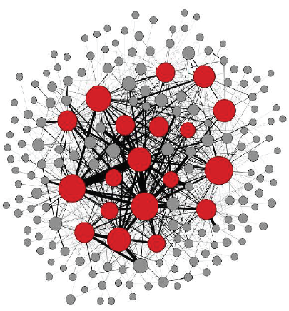
User
Developers
(contributer)
Committer
[Bosu & Carver 2014]
All of these developers collaborate using the Internet in a virtual coherent community associated to the product and its technology.
[Holk & Zigari 2007]

Slide 43
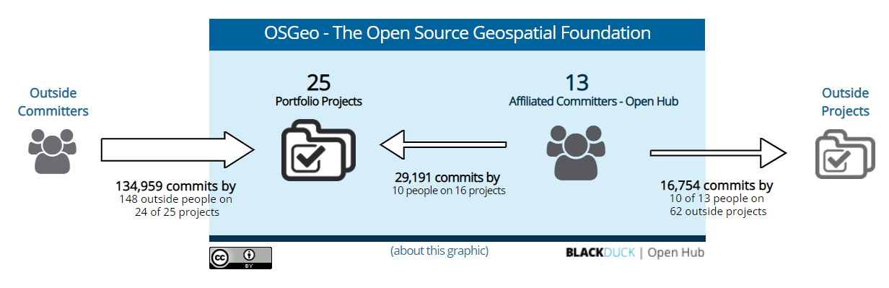
Committers and Commits „OSGeo Environment"
https://www.openhub.net/orgs/OSGeo

Slide 44
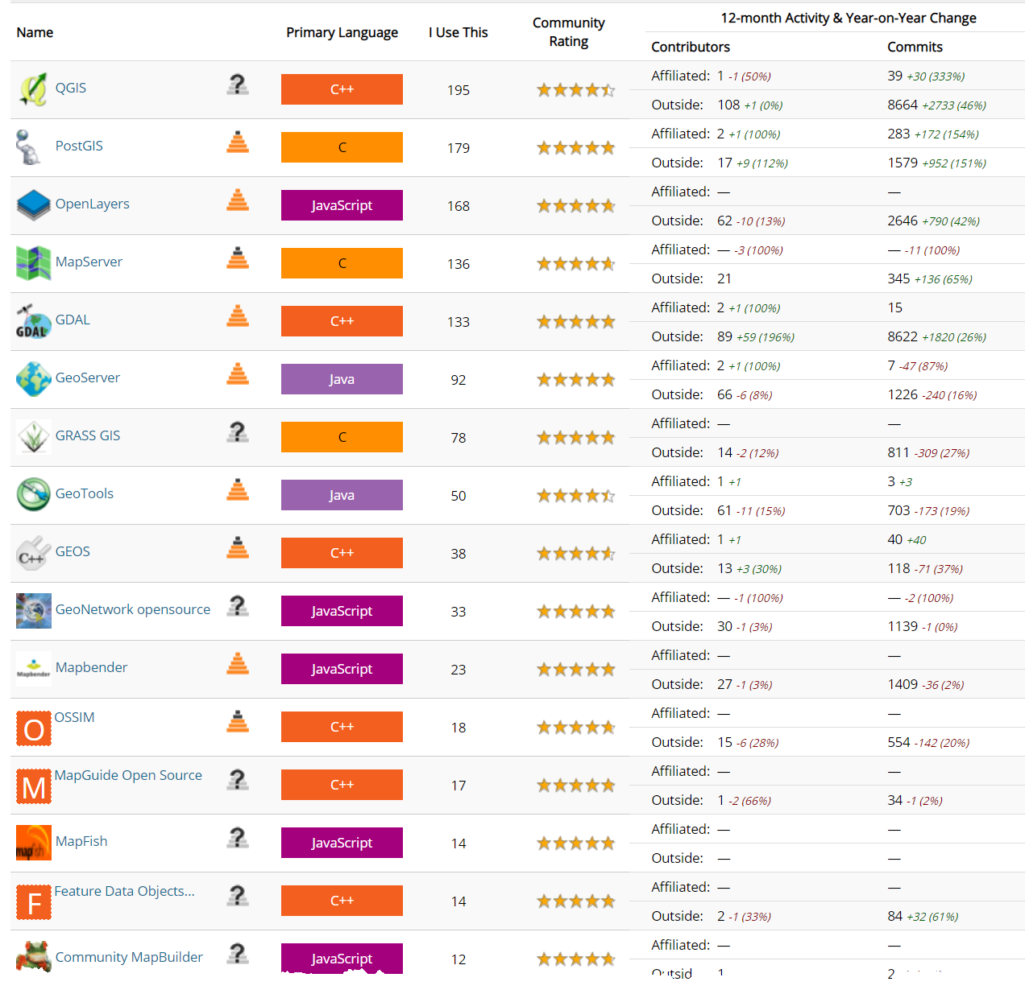
https://www.openhub.net/orgs/OSGeo [2018-10-10]

Slide 45
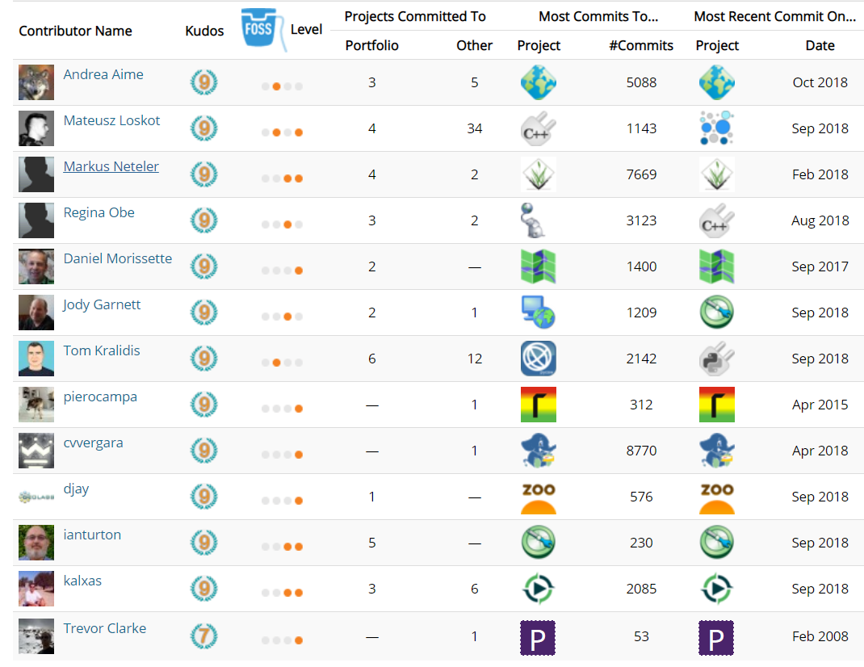
Affiliated Committers
https://www.openhub.net/orgs/OSGeo/affiliated_committers [2018-10-11]

Slide 46
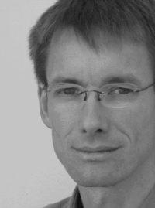
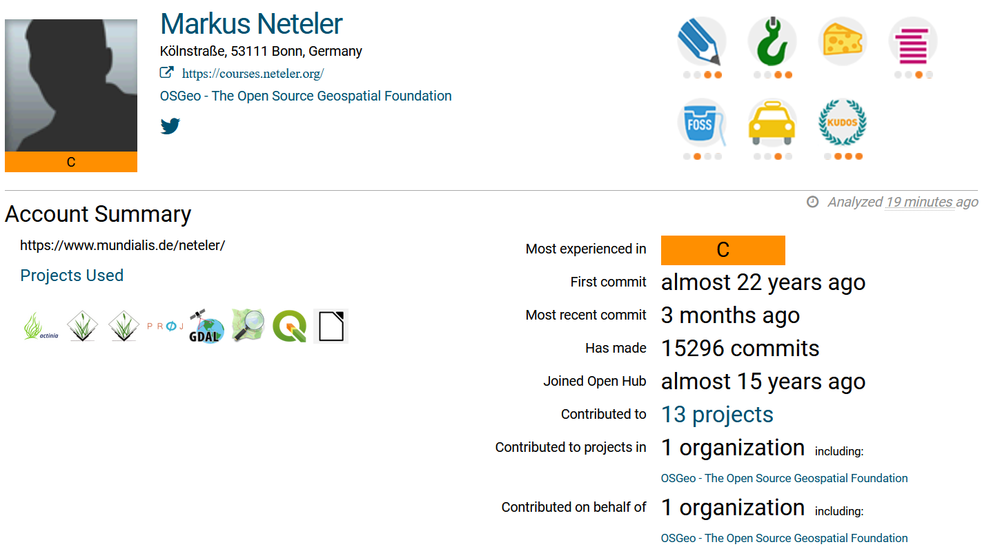
Markus's Account Summary
https://www.openhub.net/accounts/neteler
https://wiki.osgeo.org/wiki/Markus_Neteler

Slide 47
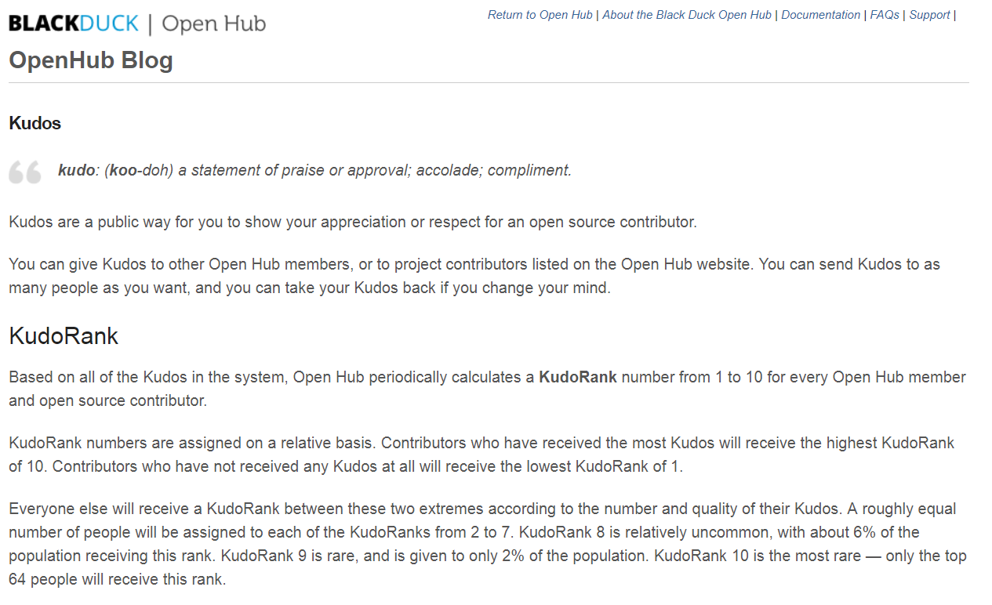
https://blog.openhub.net/kudos/ [2018-10-11]

Slide 48
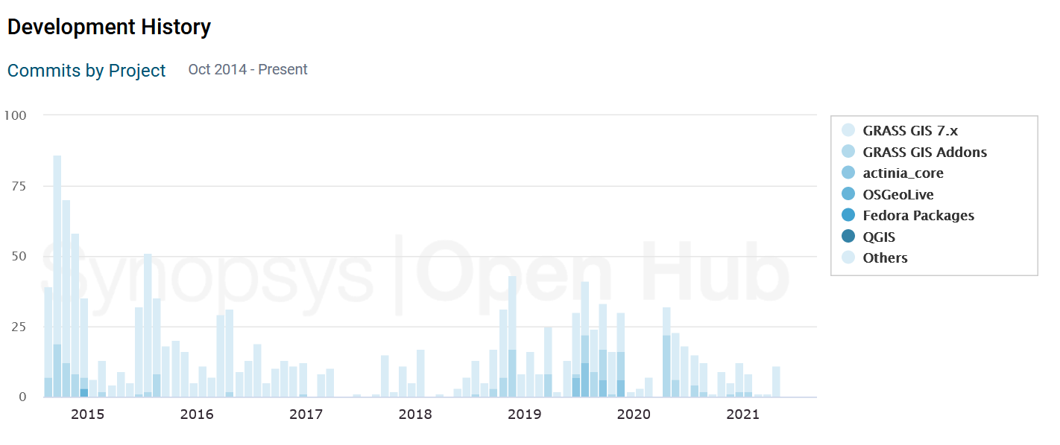
Development History

Slide 49
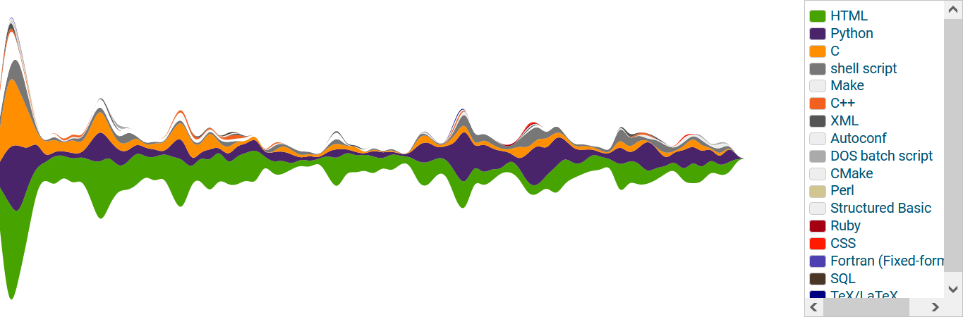
Commits by language (2018-2021)

Slide 50
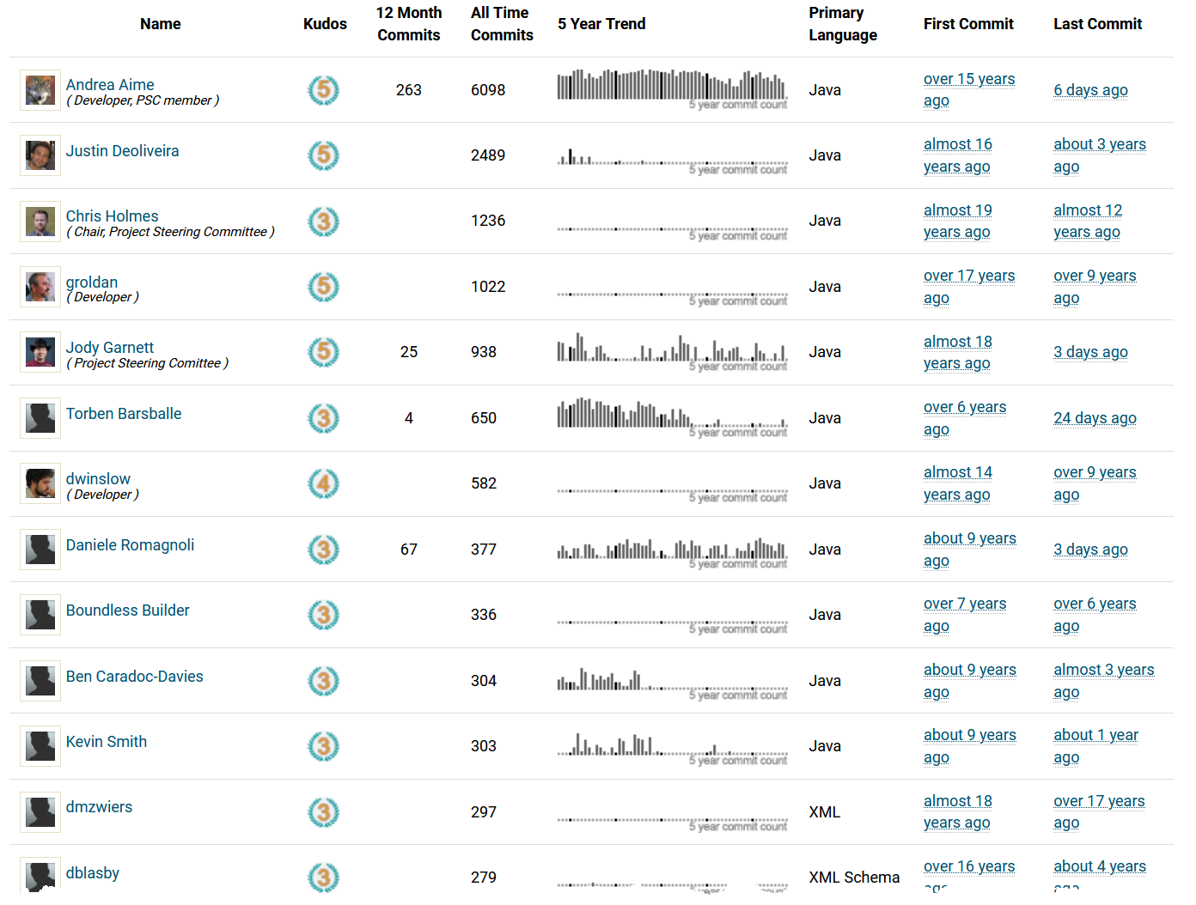
Reputation as "Top Developer“ (Geoserver)
H2021-10-01ttps://www.openhub.net/p/geoserver/contributors []

Slide 51
Project
Kernel
Member
Members leaving
Internal communication

Slide 52
Technical Interest

Slide 53
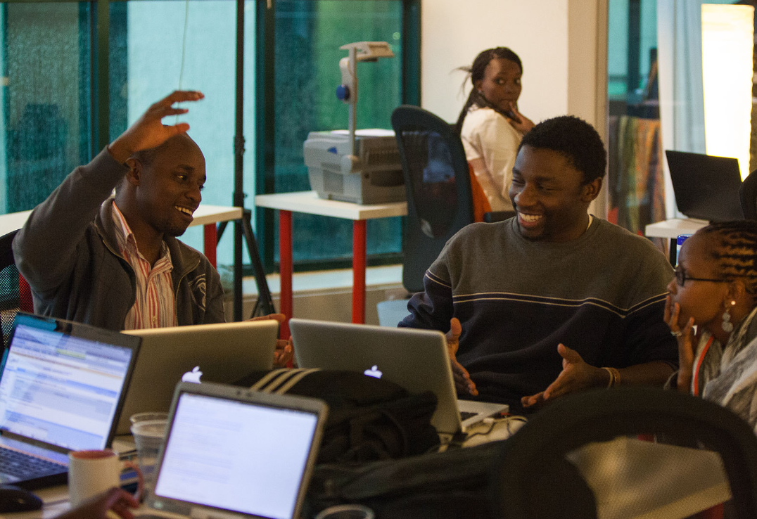
Technical Interest: The Hacker
By Matt Biddulph from UK - late night hackers at Science Hack Day, CC BY-SA 2.0, https://commons.wikimedia.org/w/index.php?curid=37715888
https://upload.wikimedia.org/wikipedia/commons/0/0d/Science_Hack_Day_Nairobi_2012.jpg [2018-10-17]
Notes:
If we continue with the psycho-social background we come to the so-called “hacker”
The Hacker Ethic:
Access to computers—and anything that might teach you something about the way the world works—should be unlimited and total.
Hackers believe that essential lessons can be learned about the systems—about the world—from taking things apart, seeing how they work, and using this knowledge to create new and even more interesting things. They resent any person, physical barrier, or law that tries to keep them from doing this.

Slide 54
Technical Interest: The Hacker
Hacker [RFC 1983]
A person who delights in having an intimate understanding of the internal workings of a system, computers and computer networks in particular.
The term is often misused in a pejorative context, where "cracker" would be the correct term.
https://tools.ietf.org/html/rfc1983
Notes:
We have to differentiate between hacker and cracker.
A cracker is an individual who attempts to access computer systems without authorization. These individuals are often malicious, as opposed to hackers, and have many means at their disposal for breaking into a system. See also: hacker, Computer Emergency Response Team, Trojan Horse, virus, worm.

Slide 55
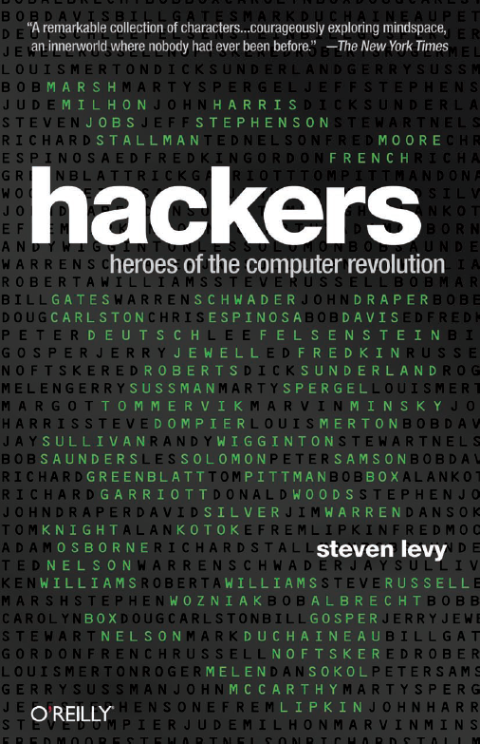
Hacker ethics
Access to computers - and anything which might teach you something about the way the world really works - should be unlimited and total. Always yield to the Hands-On Imperative!
All information should be free.
Mistrust authority - promote decentralization.
Hackers should be judged by their acting, not bogus criteria such as degrees, age, race, or position.
You can create art and beauty on a computer.
Computers can change your life for the better.
Don't litter other people's data.
Make public data available, protect private data.
After Steven Levy: Hackers (1985:27) and
https://www.ccc.de/en/hackerethics?language=en
Notes:
Der Zugang zu Computern und allem, was einem zeigen kann, wie diese Welt funktioniert, sollte unbegrenzt und vollständig sein.
Alle Informationen müssen frei sein.
Misstraue Autoritäten - fördere Dezentralisierung
Beurteile einen Hacker nach dem, was er tut und nicht nach üblichen Kriterien wie Aussehen, Alter, Rasse, Geschlecht oder gesellschaftlicher Stellung.
Man kann mit einem Computer Kunst und Schönheit schaffen.
Computer können dein Leben zum Besseren verändern.
http://www.ccc.de/hackerethics?language=de

Slide 56
Further Motivational Factors I
 | Community Believers | Learning & Fun | Hobbyists | Professionals
 | 19% | 29% | 27% | 25%
Key Motivators | “I believe source code should be open” | “My activity on this project improves my programming skills” | Non-work needs for the code | Work needs for the code Enhances prof. and OS community status
Work & Lifestyle | Hacking is central to lifestyle | Most likely to be a student | Closely identifies with hacker community | Most likely to hack as part of their job Extensive programming experience
Creativity & Leadership | Finding projects to be as creative as anything they have done Report experiences similar to “flow” and other creativity-related phenomena Want peer leaders, not traditional project managers
[Lakhani, Wolf & Bates (2002)]

Slide 57
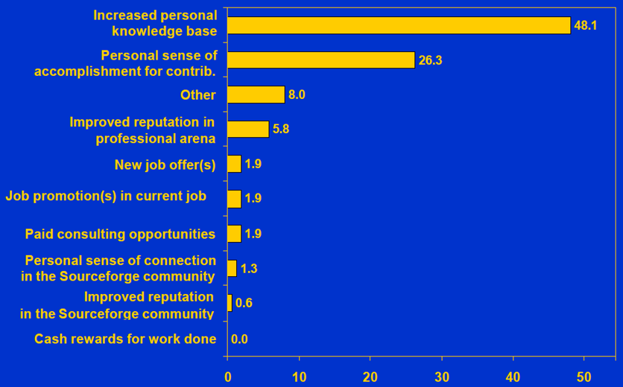
Further Motivational Factors II
[Lakhani, Wolf & Bates (2002)]

Slide 58
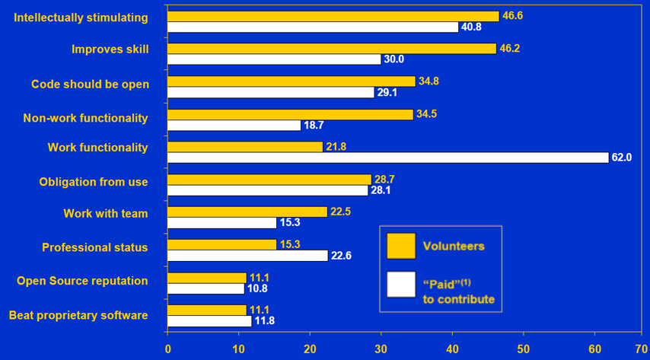
Further Motivational Factors III
[Lakhani, Wolf & Bates (2002)]
Notes:
OSS programmers may participate in stimulating projects to expand their own skill base. Working on open source projects can lead to better job opportunities, higher salaries and more fulfilling jobs. Programmers can also choose learning experiences that fit their interests.

Slide 59
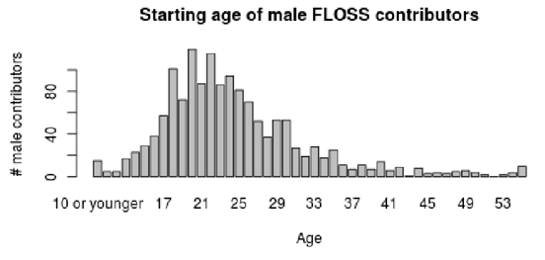
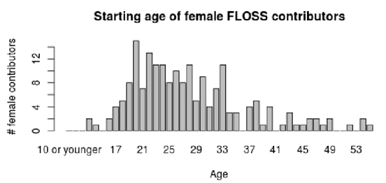
Age distribution
[Robles et al. 2014]

Slide 60
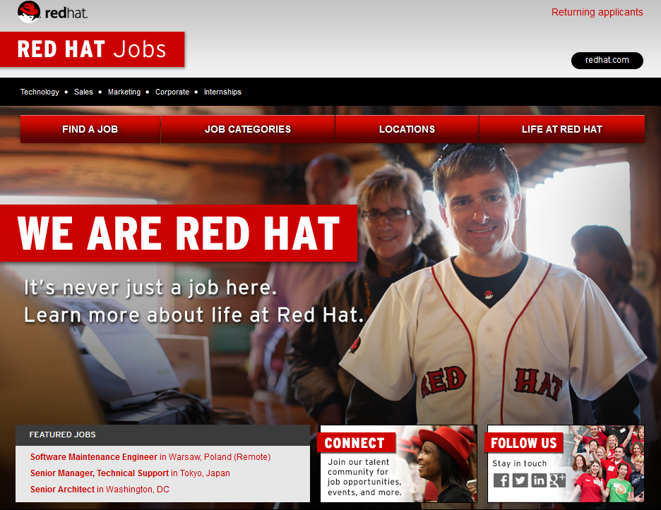
https://www.redhat.com/de/jobs?intcmp=7016000000155fjAAA
Notes:
OSS programmers may participate in projects to expand their own skill base. Working on open source projects can lead to better job opportunities, higher salaries and more fulfilling jobs. Programmers can also choose learning experiences that fit their interests.

Slide 61

Developers' Code of conduct
The Contributor Covenant, https://www.contributor-covenant.org/
a code of conduct for free/open source projects, created by Coraline Ada Ehmke
used in prominent projects including Linux, Ruby on Rails, Swift, Golang, …
Relevant signers include Google, Apple, Microsoft, Eclipse and Gitlab (https://www.contributor-covenant.org/adopters)
Coraline Ada Ehmke
By Coraline Ada Ehmke - Coraline Ada Ehmke, CC BY-SA 4.0, https://commons.wikimedia.org/w/index.php?curid=60784171

Slide 62
How is this feasible?

Slide 63
Open Source developers
(as well as often Closed Source Developers)
use Open Source.

Slide 64
Apache HTTP-Server: ~50% Market Share
Many/all of us use Open Source products:
Wordpress
Eclipse
Apple IOS
Gimp
Firefox
OpenOffice
LibreOffice
LaTeX
Notepad++
Android

Slide 65
Revenue in IT
~ 90%: Services
< 10%: Revenue of Software Licensing

Slide 66
Open Source Development
Public access to code improves the quality
Typically bugs are fixed faster
Often more secure due to multiple scrutiny
Innovation is easier – and...
Users have full control about what they get
...and many more advantages.
Read http://producingoss.org by Karl Fogel for details

Slide 67
Open Source Business
Niche Market
"highly sophisticated products that solve a specific set of problems" [Holk & Zigari 2007]
Geoinformatics?

Slide 68
Open Source Business
Niche Market
"highly sophisticated products that solve a specific set of problems" [Holk & Zigari 2007]
Consulting
Spezialized Distributions
Implementation of extensions
Geoinformatics?
Support
bug fixing
Crowd Funding
Training and Education
Service Level Agreement
Maintenance
[Kooths, Langenfurth, Kalwey 2003]
Notes:
68
Weil sich mit Verbesserungen an der Open Source-Software
keine direkten Erlöse durch Lizenzen erzielen lassen, müssen Firmen indirekt über andere Produkte
und Dienste von der Open Source-Entwicklung profitieren.
Open Source-
Businessmodelle können daher als indirekte Businessmodelle bezeichnet werden,
denn Umsätze werden nicht mit dem eigentlichen Produkt erwirtschaftet, sondern
mit zusätzlichen, darauf aufbauenden Produkten und Diensten

Slide 69
Open Source is used often internally in Closed Source
Autodesk
Oracle
Esri
IBM
Google
Microsoft
HP
Adobe

Slide 70
Usage of Open Source in Closed Source
”an average product or application contains almost 700 MB of code, 22% of which is open source software … almost 80% of newly deployed code is Open Source” [1]
"44% of all code was Open Source ” [2]
"sampling continues to find that between 30 and 70% of code submitted as Internally developed is identifiably from third-parties, most often in the form of Open Source components and Commercial libraries” [3]
zit. nach Carlo Daffara (2012): Estimating the economic contribution of Open Source Software to the European economy. In: Shane Coughlan (Hrsg.) (2012) The First OpenForum Academy Conference Proceedings
[1] McQuaide, B., “Distributed Multi-Source Development with Open Source:”, LinuxCon 2010
[2] Daffara, C. “The Economic Value of Open Source Software”. Submitted presentation, TransferSummit Oxford 2010
[3] Veracode, “State of Software Security Report volume 3”, 2011

Slide 71
Open Source contributes significantly to economy
Autodesk
Oracle
Esri
IBM
Google
Microsoft
HP
Adobe

Slide 72
Contribution to to economy
2005: HP reported Linux-related revenues higher than 2.5B$ [1]
2005: IBM reports OSS-related revenues of 4.5B$ [1]
"[…] Open Source does have at least an immediate economic effect through code reuse and effort reduction […] [of] at least 114B€/year, through direct savings, reduction in project failure and improvements in code maintenance costs - equivalent to 30% of the entire software and services market. " [1]
[1] Carlo Daffara (2012): Estimating the economic contribution of Open Source Software to the European economy. In: In: Shane Coughlan (Hrsg.) (2012) The First OpenForum Academy Conference Proceedings

Slide 73
Some economic key indicators (OS in general)
Lawton and Notarfonzo state that packaged open source applications generated revenues of $1.8 billion in 2006 […]. The software division of the Software & Information Industry Association estimates that total packaged software revenues were $235 billion in 2006 […].
Our work shows that the additions to open source projects, the total project size (measured in source lines of code), the number of new open source projects, and the total number of open source projects are growing at an exponential rate. The total amount of source code and the total number of projects double about every 14 months.
RedHat: 1.8 Billion US$ a year!
[http://dirkriehle.com/publications/2008-2/the-total-growth-of-open-source/]

Slide 74
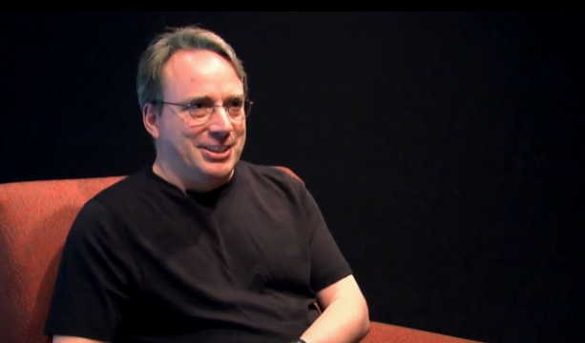
"Linux made it clear how well open source works, not just from a technical standpoint, but also from a business, commercial, and community standpoint."
Linus Torvalds, 2014
[ http://www.infoworld.com/article/2608107/linux/linus-torvalds-to-developers--to-succeed--make-it-personal.html]
Notes:
If we talk about Open Source of course Linus Torvald may not be omitted.
Indeed, the success of Linux is a key indicator that Open Source can be applied successfully as an development methodology.

Slide 75
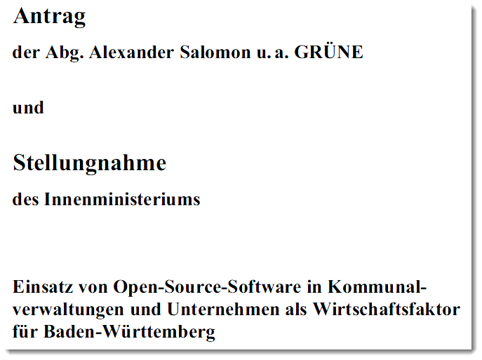
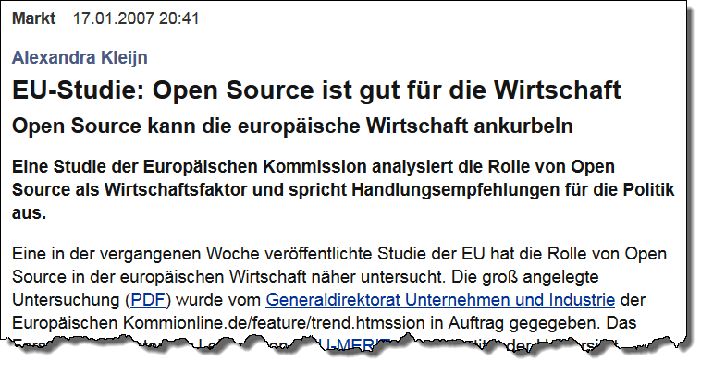
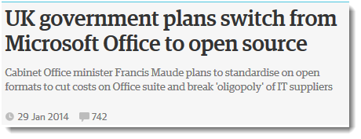
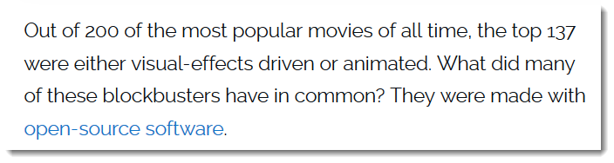



https://www.zdnet.com/article/hollywood-goes-open-source/
Source: a.o. http://www.heise.de/open/artikel/EU-Studie-Open-Source-ist-gut-fuer-die-Wirtschaft-222037.html
US Department of Defence (2009: Clarifying Guidance Regarding Open Source Software (OSS). https://dodcio.defense.gov/Portals/0/Documents/OSSFAQ/2009OSS.pdf [2018-10-09]

Slide 76


https://www.heise.de/news/Bund-Microsoft-Kosten-seit-2015-fast-vervierfacht-auf-178-Millionen-Euro-5047929.html?utm_source=pocket-newtab-global-de-DE [2021-02-15]
https://twitter.com/peterganten

Slide 77

https://www.zdnet.com/article/hollywood-goes-open-source/

Slide 78









Slide 79

Gesamter IT-Sektor
Open Source-Wirtschaft
Source: M. J. Skok, http://de.slideshare.net/mjskok/2014-future-of-open-source-8th-annual-survey-results
"die Open Source-Software bietet […] keine neuen, sondern nur einen Teil der bereits auf dem kommerziellen Softwaremarkt gegebenen Geschäftsmöglichkeiten.
Diese wirken gesamtwirtschaftlich substitutiv und nicht additiv." [Kooths et al. 2003]

Slide 80



Business modell:
"Selling additional hardware"?
http://www.apple.com/opensource/ [2018-10-11]

Slide 81

Microsoft
[1] https://www.zdnet.com/article/microsoft-open-sources-its-entire-patent-portfolio/
[2] https://www.zdnet.com/article/microsoft-open-sources-its-entire-patent-portfolio/
"We recognized open source is something that every developer can benefit from. It's not nice, it's essential. It's not just code, it's community. We don't just throw code on the website. We openly publish our roadmap, and we have 20,000 Microsoft employees on GitHub. With over 2,000 open-source projects, we're the largest open-source project supporter in the world."
Scott Guthrie, Microsoft's executive vice president of the cloud and enterprise group [2]

Slide 82
Visibility
Collaboration
Acknowledged rules

Slide 83
OSGeo's Goals
Provide resources for FOSS4G projects:
  Infrastructure
  Legal frame
  Financial support
Promote free and open spatial data
Create and maintain a quality brand
Create and promote free curriculua
Promote and contribute to standards

Slide 84
OSGeo Activities
On a global scale:
  Provide mature software solutions
  Support FOSS4G, an international open source conference for geospatial application (2013: UK, 2014: USA, 2015: Korea, 2016. Germany, 2017: USA, 2018: Tansania, 2019: Romania, 2021: Buenos Aires)
Support local activities and capacities
  Local open source conference for geospatial application (i.e. FOSS4G-SEA)
  Local chapters (India, Maylsia, ...)
Facilitate inter-project communication
Build a solid market for businesses and users
Interface with industry and business
Support the education of domain experts not «brand-specialists»
...

Slide 85


Formal Structure
Charter Members vote
Board of 9 Directors
and President
Officers
Officers
35 Officers
Executive
Director
appoints
represent
Committees
Committees
Committees
Local
Chapters
Local
Chapters
Local
Chapters
Foundation
Projects
Local
Chapters
Local
Chapters
elected by membership
>400 Charter Members
Sponsors
85/42
Notes:
85

Slide 86
Projects
Mapbender
UMN
Mapserver
QGIS
OSSIM
MapBuilder
Map Guide
OS
GRASS
GIS
gvSIG
Desktop GIS
OpenLayers
deegree
FDO
GDAL/OGR
GeoServer
Web Mapping
GEOS
GeoTools
MetaCRS
PostGIS
GeoNetwork
Libraries
Metadata

Slide 87

Software using GDAL

Slide 88

GDAL: Supported Vector formats

Slide 89

Committees
Incubation
Education
Geodata
https://www.osgeo.org/about/committees/
Commitees: self organised
Voluntary work
Communication by mailing lists, webinars, IRC, meetings,.
An option for you?
Website
Conference
Journal
Sysadmin
Marketing
other...
Notes:
89

Slide 90
Incubation Committee
https://www.osgeo.org/about/committees/incubation/
Incubation
Education
Geodata
Website
Conference
Journal
Sysadmin
Marketing
other...
2011 Cambridge Conference
Notes:
90

Slide 91
Incubation Process
Projects can apply for inspection by the OSGeo Incubation Committee.
Project have to abide by OSGeo rules and satisfy a catalog of criteria
  Copyright, licenses, ownership
  Development process quality
  Documentation, tutorials, support
  Community
OSGeo tag is a proof of quality
More details are available on the Web:
http://wiki.osgeo.org/wiki/Incubation
Notes:
What is inspected?
Copyright, licenses, ownership
Development process quality
Documentation, tutorials, support
Community functioning

Slide 92
Incubation
Education
Geodata
Website
Conference
Journal
Sysadmin
Marketing
other...
OSGeo - Spatially Empowered Open Source
92/42
Notes:
92

Slide 93

ICA & OSGeo (& ISPRS) MoU
Nuremberg, Germany - September 27, 2011
Aims: developing on a global basis collaboration opportunities for academia, industry and government organizations in open source GIS software and data
  provide expertise and support for the establishment of Open Source Geospatial Laboratories and Research Centres across the world for supporting development of open-source geospatial software technologies, training and expertise.
  to provide support for building-up and supporting development of open source GIS teaching and training materials, joint organization of open source GIS events, workshops through the ICA network for wider participation globally etc.
https://wiki.osgeo.org/images/b/b4/Mou_ica-osgeo.jpg [2018-10-15]
See https://wiki.osgeo.org/wiki/MOU_ISPRS and https://wiki.osgeo.org/wiki/MOU_ISPRS
Notes:
the aim of developing on a global basis collaboration opportunities for academia, industry and government organizations in open source GIS software and data. The MoU aims to provide expertise and support for the establishment of Open Source Geospatial Laboratories and Research Centres across the world for supporting development of open-source geospatial software technologies, training and expertise. In the first phase five laboratories will be established, one each in Asia, Europe, Africa, the Americas and Australasia which will act as nodes for future expansion. It also aims to provide support for building-up and supporting development of open source GIS teaching and training materials, joint organization of open source GIS events, workshops through the ICA network for wider participation globally etc.
OSGeo is a not-for-profit organization founded in 2006 whose mission is to support and promote the collaborative development of open source geospatial technologies and data.
ICA is the world authoritative body for cartography, the discipline dealing with the conception, production, dissemination and study of maps.
93

Slide 94

ICA/OSGeo Labs
Mission - "Making geospatial education and opportunities accessible to all“
  https://www.osgeo.org/initiatives/geo-for-all/ [2021-10-02]

Slide 95

OSGEO Live DVD
originally compiled by Cameron Shorter, and one of the coordinators of the OSGeo-Live Project.
a bootable DVD, based on the Xubuntu linux distribution, pre-installed and pre-configured with close to 50 of the best GeoSpatial Open Source applications along with sample datasets.
OSGeo-Live can also be run from a USB flash drive, installed into a Virtual Machine, or installed onto your hard drive.
Cameron Shorter
Source: http://cameron.shorter.net/resume.html [2018-10-15]

Slide 96
Benefits for education and personal progress
Students [Ertz, Rey, Joost 2014]
  can install Open Source Software without limit tions locally installieren and evaluate it (also in combination with Closed Software),
  can find ther own way for their further professional life,
  can read software and analyze ist algorithms,
  can analysze and understand software development processes and communication,
  can understand Open Source as part of a general "Open"movement
Universities can
  can contribute to a broad education of their students,
  can operate more economically.

Slide 97
OSGeo Live DVD
Desktop GIS
web mapping
QGIS
QGIS Server
OSSIM
UMN
MapServer
GRASS GIS
OpenStreetMap
Mapnik
uDig
Geopublisher
gvSIG
deegree
GeoMajas
KOSMO
deegree GIS
ZOO Project
MapFish
GMT
MapGuide OS
GDAL/OGR
FDO
OpenLayers
GeoKettle
GeoServer
Mapbender
GeoTools
GEOS
MetaCRS
PostGIS
GeoNetwork
Viking
Application Server
SpatialLite
Libraries
Metadata
Notes:
97

Slide 98
Formal Structure
Charter Members vote
Board of 9 Directors
and President
Officers
Officers
35 Officers
Executive
Director
appoints
represent
Committees
Committees
Committees
Local
Chapters
Local
Chapters
Local
Chapters
Foundation
Projects
Local
Chapters
Local
Chapters
elected by membership
>400 Charter Members
Sponsors
98/42
Notes:
98

Slide 99
Formal Structure
Charter Members vote
Foundation Sponsorship
  Help sustain the organization
  Priority Access to Conferences and Events
  Executive and Expert Contacts
Project Sponsorship
  Fund specific functionality (i.e. OpenLayers 3)
  Priority bug fixing
  Influencing future development
Board of 9 Directors
and President
Officers
Officers
35 Officers
Executive
Director
appoints
represent
Committees
Committees
Committees
Local
Chapters
Local
Chapters
Local
Chapters
Foundation
Projects
Local
Chapters
Local
Chapters
elected by membership
>400 Charter Members
Sponsors
99/42
Notes:
99

Slide 100
Summary and
Outlook

Slide 101
We have heard something…
Commons and the Tragedy of Commons
Open Source Software as part of Knowledge commons
Limitless use does not decrement the resource.
However Commons need a community and a set of rules.
Intrinsic motivational factors: Freedom, Community, Technical Interest, livelihood
OSGeo Foundation as a community provides an environment to handle the commons of geospatial Open Source Software

Slide 102


We have to learn
See Paul Ramsey's brillant talk:
https://vimeo.com/76365035
http://www.how2map.com/2013/

Slide 103
Change is required
"Microsoft took years of internal change and deep consideration to make this fundamental change in both its business model and how it develops it software. In the end, open-source has won, and Microsoft is now a fully fledged open-source company. If they can do it, you can do it."
Steven J. Vaughan-Nichols (2018): Microsoft open-sources its patent portfolio. https://www.zdnet.com/article/microsoft-open-sources-its-entire-patent-portfolio/ [2018-10-03]

Slide 104
Use Open Source in Conjunction with Closed Source
Open Source secures your investments.

Slide 105
Open Source (and OSGeo) require our participation and our joint support of the development process.
Partizipation comprises
      Usage,
      Education,
      Testing, Translating,
      Support of the community by hiring, financing further developments.
By Alexander W. Galbraith [Public domain or Public domain], via Wikimedia Commons
https://upload.wikimedia.org/wikipedia/commons/a/ab/Barn_raising_in_Lansing.jpg

Slide 106
Companies
User
Nutzer
User
user
Nutzer
Doku-menta-tion
Organi-sation
User
Organi-sation
Trans_lation
Project
Testing
Media
Testing
Volunt. develo-per
paid develo-per
Volunt. develo-per
Volunt. develo-per
paid develo-per
Volunt. develo-per
paid develo-per
paid develo-per

Slide 107
But the ultimate success of the free software movement depends upon teaching our friends, neighbors and work colleagues about the danger of not having software freedom, about the danger of a society losing control over its computing.
https://www.fsf.org/about/ [2014-11-19]

Slide 108

A suggestion for the Youngsters: Go ahead!
https://www.forbes.com/profile/jack-laura-dangermond/?list=billionaires [2018-05-09]
Notes:
Dangermond never took outside financing, and other than a $5,000 loan from his mother in the early days, Esri never borrowed money. It has been profitable since day one.
https://www.forbes.com/sites/miguelhelft/2016/02/10/the-godfather-of-digital-maps/#4c9aa4c74da9
"We kept ownership of our company and grew to it be what it is today. It gives some sense of what American business can be. It can grow from nothing, with people's imaginations, into advanced technology that makes a difference."

Slide 109

http://georeferenced.files.wordpress.com/2014/03/openclose_flickr_leo_reynolds_cc.jpg

Slide 111
"I had some notion of applying computer mapping to my profession," he says, "but frankly I was just very excited by the technology and curious how it could be made useful."
https://www.forbes.com/sites/miguelhelft/2016/02/10/the-godfather-of-digital-maps/#4c9aa4c74da9 [2018-10-11]

Slide 112
Open vs.
Close Source

Slide 113
Closed Source Products can be discontinued.

Slide 114




http://geocoderblog.tomtom.com/ [2015-04-28]
https://developers.google.com/earth/ [2016-12-06]

Slide 115
Open Source Products can be maintained by others.

Slide 116

https://developer.yahoo.com/boss/placefinder/ [2018-04-15]
Subject: =?utf-8?Q?Mapzen=20is=20shutting=20down.=C2=A0?=
From: =?utf-8?Q?Mapzen?= <hello@mapzen.com>
To: <franz-josef.behr@hft-stuttgart.de>Date: Tue, 2 Jan 2018 17:22:06 +0000
Message-ID: <f794ed7de022235c0f3f39991.f9637fa550.20180102172129.dd14286d4c.87fa491f@mail187.atl121.mcsv.net>

Slide 117
You are exposed to economically driven
Management Decisions

Slide 118


https://www.reddit.com/r/webdev/comments/8gkm2018-0725eo/starting_google_maps_platform_arrives_with/ [2018-10-15]
https://www.sanparks.org/tourism/maps/default.php?p_id=11 [2018-10-10]

Slide 119
Bug rate is supposed to be less compared to Closed Source

Slide 120
Open Source Development
Source Code contains all functionality (and only Source Code can be modified).
Public access to code improves the quality
Typically bugs are fixed faster
Often more secure due to multiple scrutiny
Bug rate is considered equal or smaller, especially by small OS projects
Innovation is easier – and...
Users have full control about what they get
Read http://producingoss.org by Karl Fogel for details

Slide 121
Open triggers the interests of a wide community

Slide 122


http://www.telegraph.co.uk/news/2017/10/23/stephen-hawkings-phd-crashes-university-cambridge-website-made/ [2017-11-01]
From: "DIE ZEIT: CHANCEN Brief" <chancen-brief@newsletterversand.zeit.de> Reply-To: re-2FPLAD0K-2FF4R9EA-6HW5G@newsletterversand.zeit.de To: franz-josef.behr@gis-management.de Message-ID: <re-pQjX1WCpRvMvgngaGlgm4cb79AksueEGwcsMmooj0wj4JPR-2FPLAD0K-2FF4R9EA-1J0L9H@newsletterversand.zeit.de>

Slide 123
Open Source Development: The OpenLayers Example

Slide 124
Idea of problem solving,
Implementierung
Feed back from
the users
Open Source
Project
Release (publish)
the Source Code
Download, installation, usage

Slide 125
Groups involved
Users
Mailing list-Teilnehmer
Registered developers (contributors)
Project Steering Committee (7 members, http://trac.openlayers.org/wiki/SteeringCommitteeMembers)
Committee Chair
  facilitates discussion of proposals, responsible for memberships of the Project Steering Committee.
  adjudication in cases of disputes about voting.
Democratic process: Addition and removal of members from the committee, as well as selection of a Chair should be handled as a proposal to the committee.
Notes:
keeping track of who is a member of the Project Steering Committee

Slide 126
Development Process
Clear and sound rules:
Proposal → OpenLayers Developer Mailing list → Discussion and voting (at least for two working days).
Voting::
  "+1“: indicating support for the proposal and a willingness to support implementation.
  "-1“: a veto, needs clear arguemnts and alternative approaches for problem solving
  “-0”: mild rejection; “0”: abstebtion, “+0”: light favourable opinion.
Votings of the Project Steering Committee count..
Acceptance: +2 (including the proposer), no vetos (-1).
Veto → Proposal can be newly submitted for voting

Slide 127

Versioning and tracking
Code and content: in the OpenLayers Subversion (SVN) repository, http://svn.openlayers.org/
enabling worldwide development
Project management using trac
  tracking system for bugs, feature requests, version management etc (“tickets“)
  interface to Subversion
  allows wiki-like markup in descriptions and messages, creating links and seamless references between bugs, tasks,files and wiki pages.
  timeline gives historic view of the project,
Notes:
timeline showing all project events in order, making the acquisition of an overview of the project and tracking progress easy.

Slide 128

Tracking system

